Slide 1
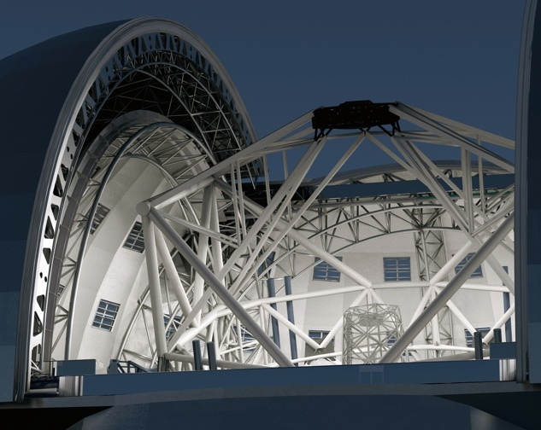
The E-ELT Project
Adrian Russell
Astronomy with Megastructures, Crete, 10 May 2010

Slide 2
The Task
ESO’s Strategic Principles
ESO Council Resolution, Dec.2004
Retention of European astronomical leadership into the era of Extremely Large Telescopes
Assure completion of ALMA, and efficiently exploit its superb scientific capabilities
Maintain VLT in world-leading position for another 10-15 years by continued upgrades
Exploit unique capabilities of the VLTI
Lead in the construction of an ELT on a competitive timescale

Slide 3
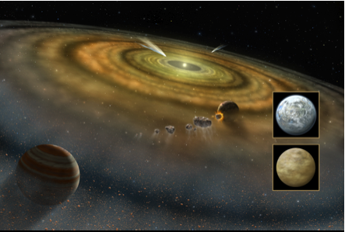
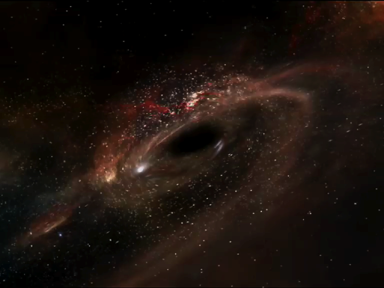
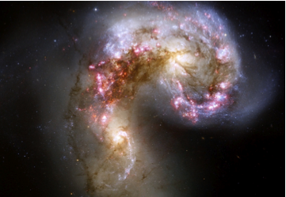
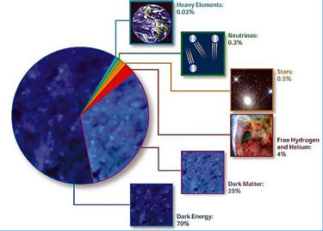
The driver
Planets in other stellar systems
  Imaging and spectroscopy
  The quest for Earth-like exo-planets
Stellar populations
  In galaxies inaccessible today (e.g. ellipticals in Virgo cluster)
  Across the whole
  history i.e. extent) of
  the Universe
Cosmology
  The first stars/galaxies
  Direct measure of
  deceleration
  Evolution of cosmic parameters
  Dark matter, dark energy
  Tests of GR around black holes
The unknown
  Open new parameter space

Slide 4
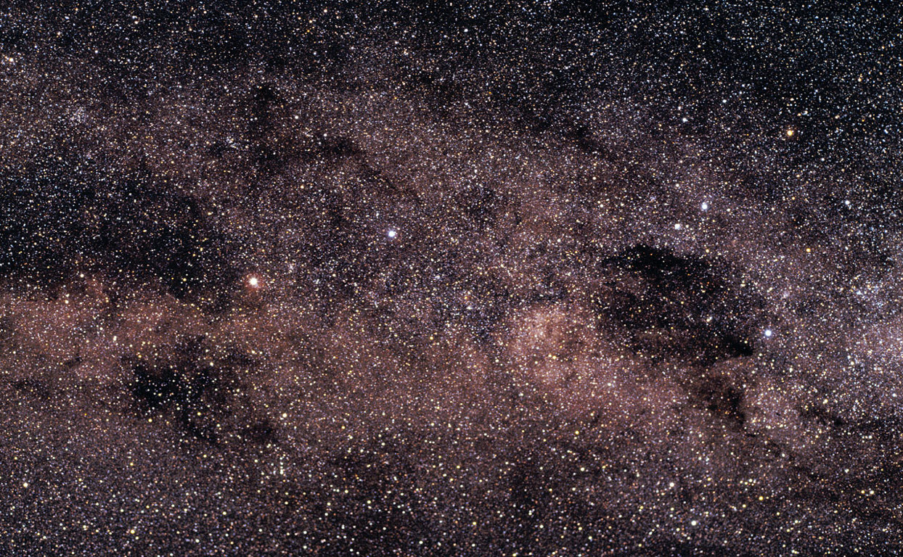
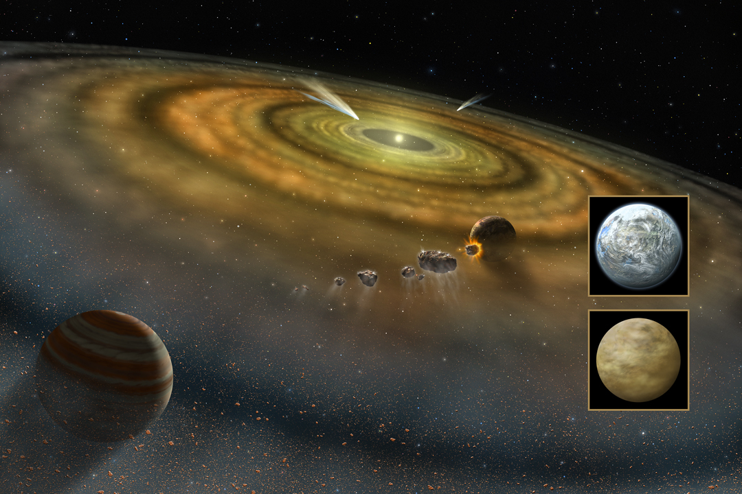
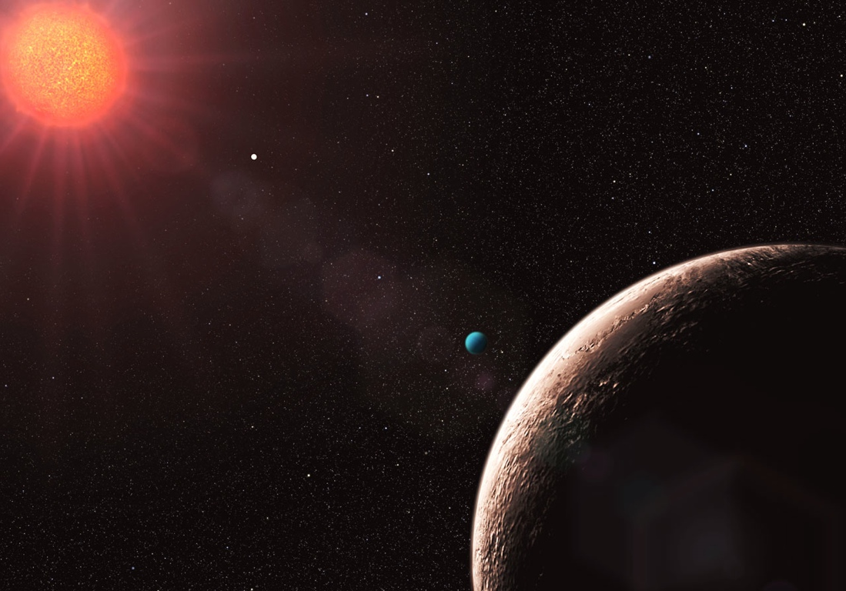
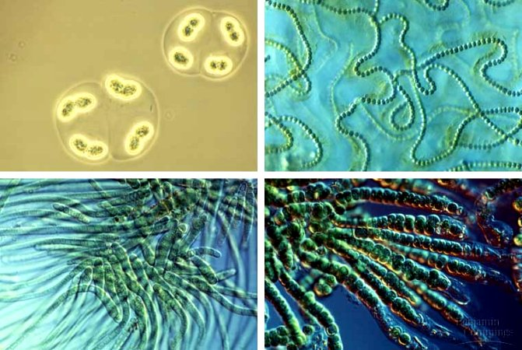
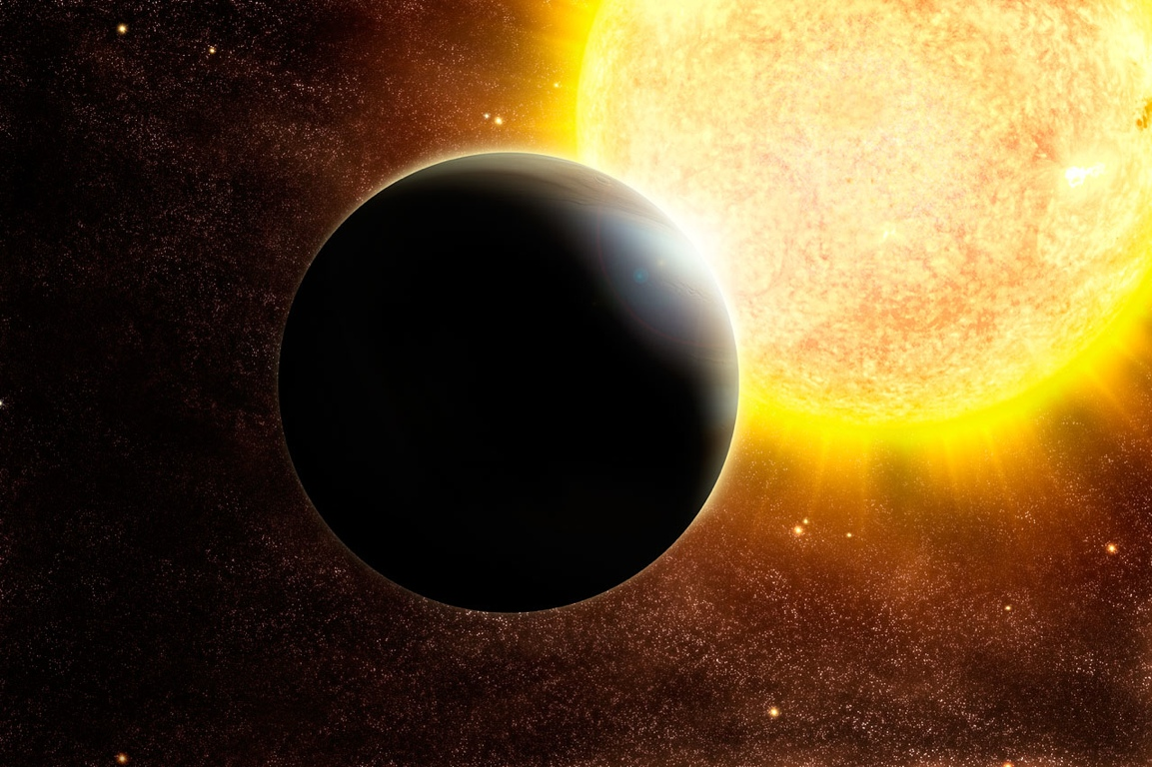
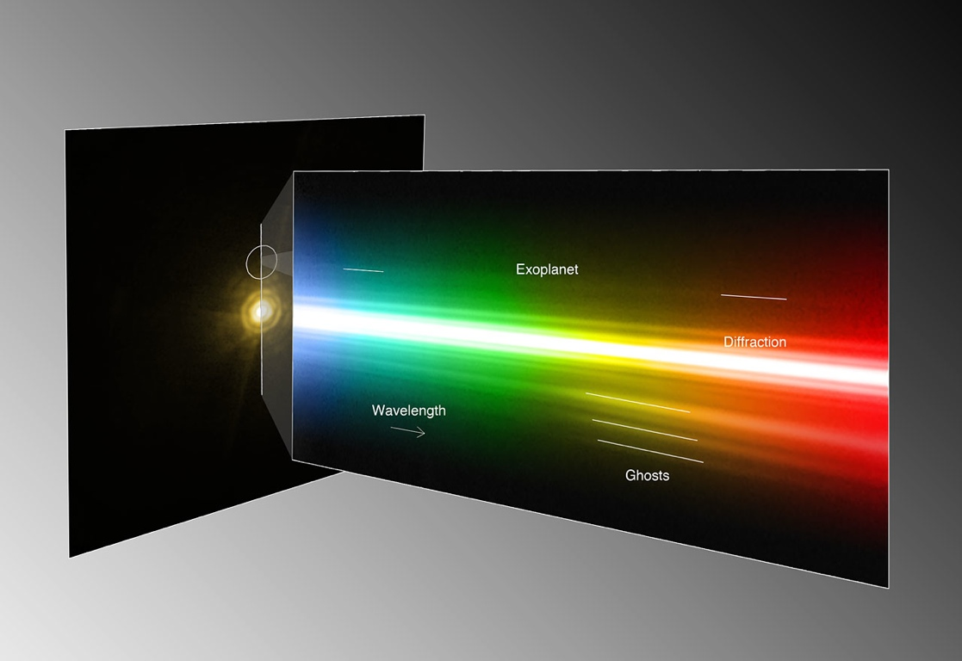
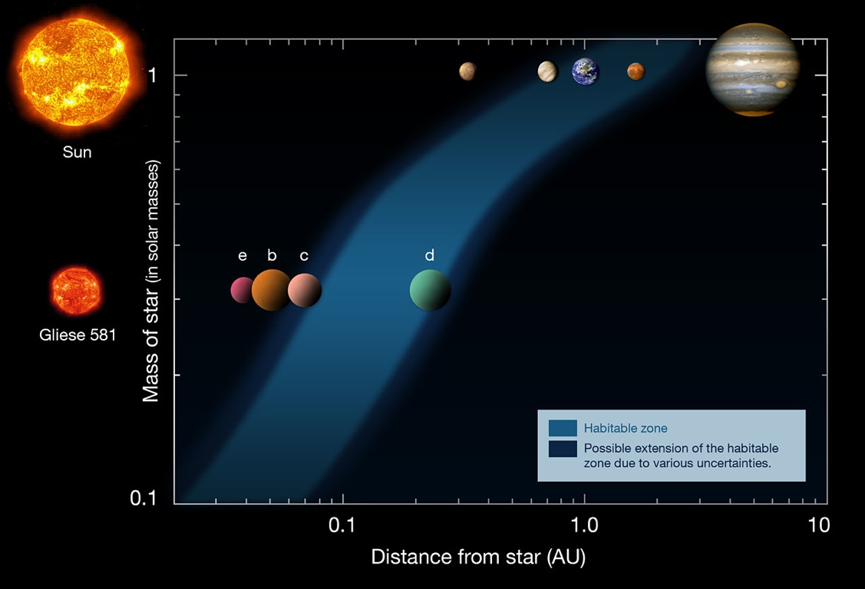

One top goal of the E-ELT is to find and to characterise exo-planets...
... it is the first telescope ever that can explore Earth-twins...
... with ultimately the chance to find life beyond the Solar system.
Notes:
Over 500 planets beyond the solar system are known today.
Most of them are exotic (as lower left): they are the size of Jupiter but very close to their stars (a year last a few days for them).
Until now we can find, but only barely characterise these exoplanets.
The E-ELT is designed (is large enough) not only to find exotic planets, but also Earth-twins. Further, it will be able to take spectra of their atmospheres, and so to search for bimomarkers, i.e. traces of life.
This is the first time that mankind has the technology to do so.

Slide 5
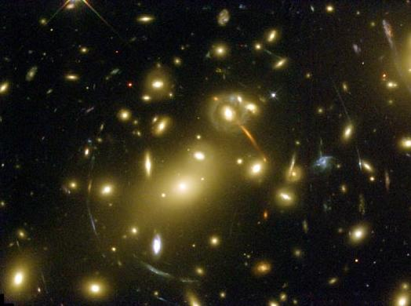
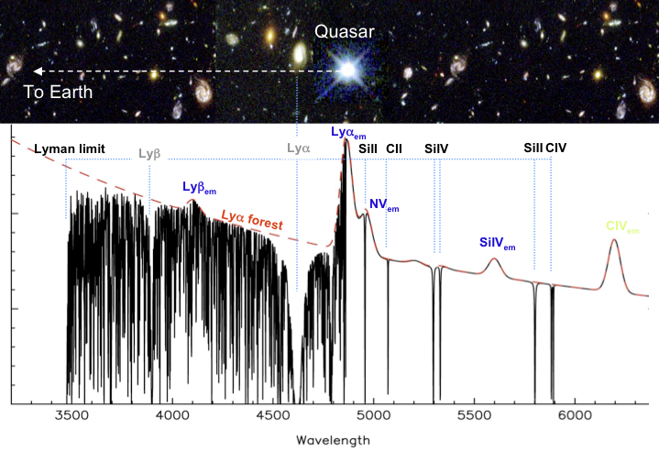
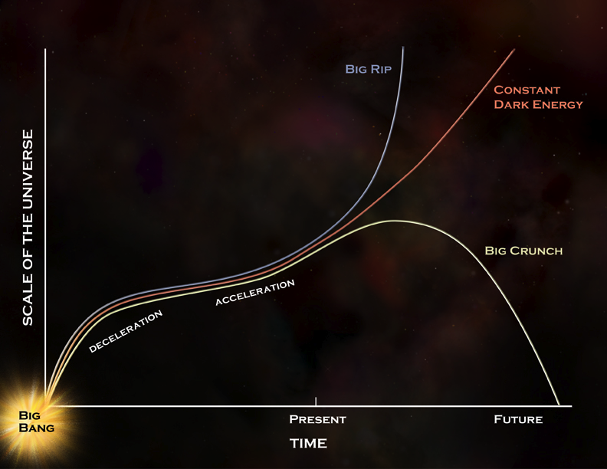
Another top goal of the E-ELT are fundamental physics...
...the E-ELT will be able to test whether todays physics were valid 10 billion years ago...
... and it will be able to trace the expansion history of the universe, providing clues about dark energy.
Notes:
The E-ELT will be able to measure precisely the different atomic transition in a given element (like Iron or Magnesium) in very distant objects (objects that are up to 10 billion light year ago). The relative wavelengths of these transitions are compared to todays values, measured in the laboratory: if they differ, the fine structure constant, i.e. fundamental physics, must have evolved during the evolution of the universe.
The E-ELT will measure the expansion velocity of many objects at different look-back times. It will repeat that experiment 10 years later, and by comparing the velocities, get the *acceleration* of the universe as a function of the universe history. I.e. we will be able to reconstruct the expansion history of the universe which is mostly driven by the mysterious dark energy.
These projects illustrate the very high interest not only of astronomers, but also of physicists for this project.

Slide 6
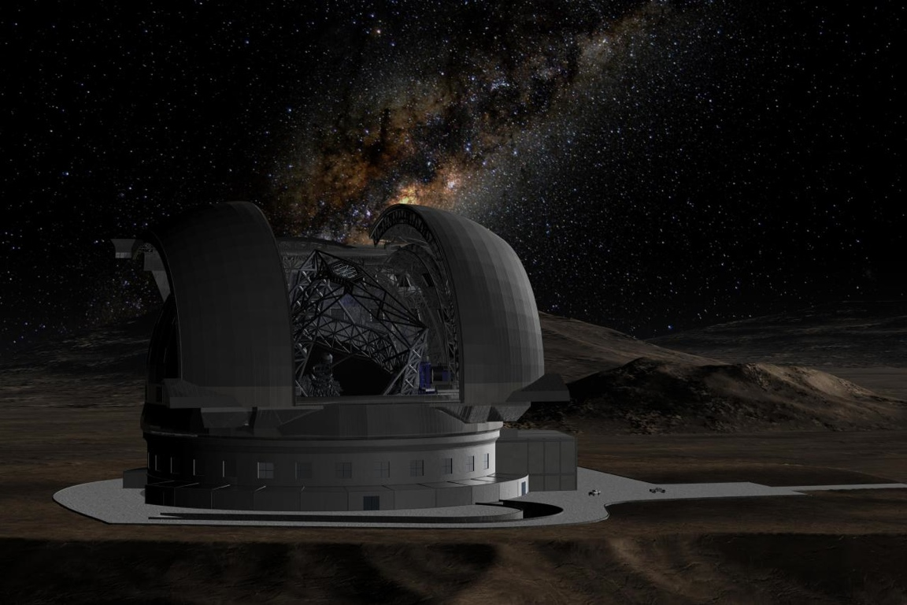
The E-ELT Design

Slide 7
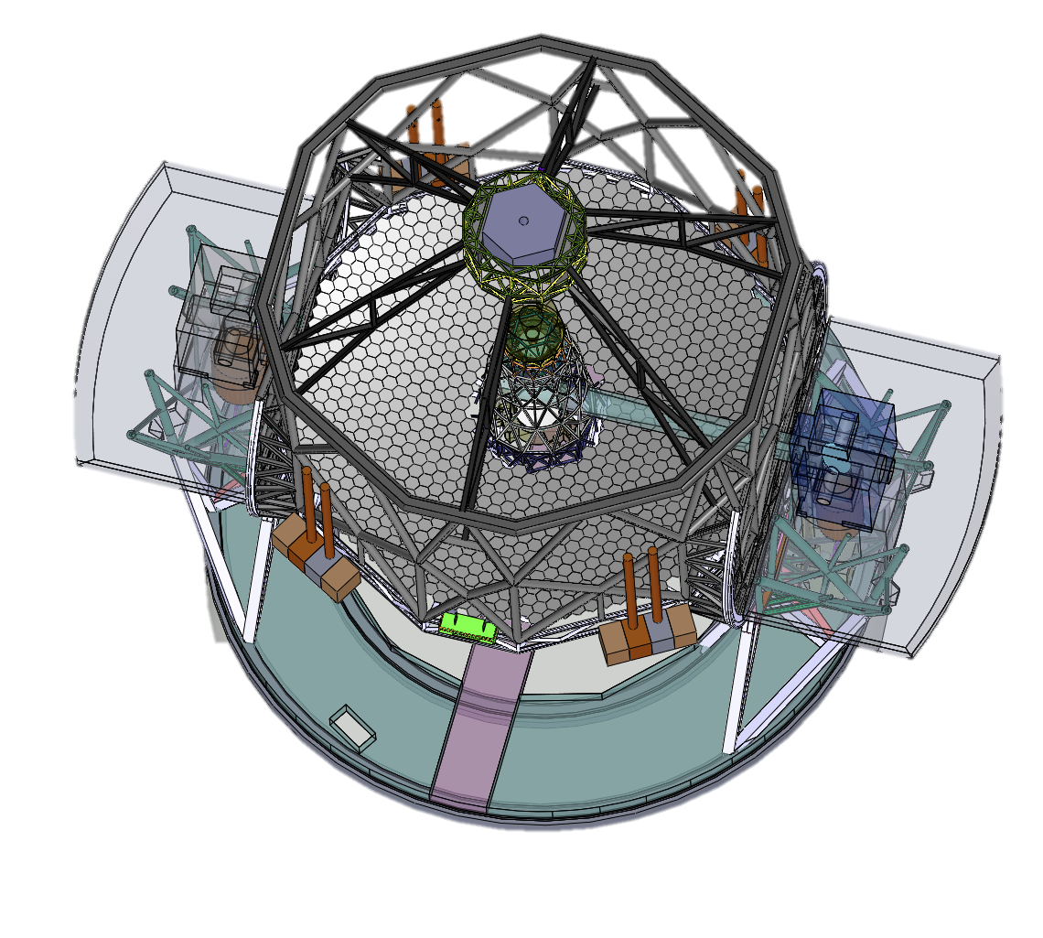
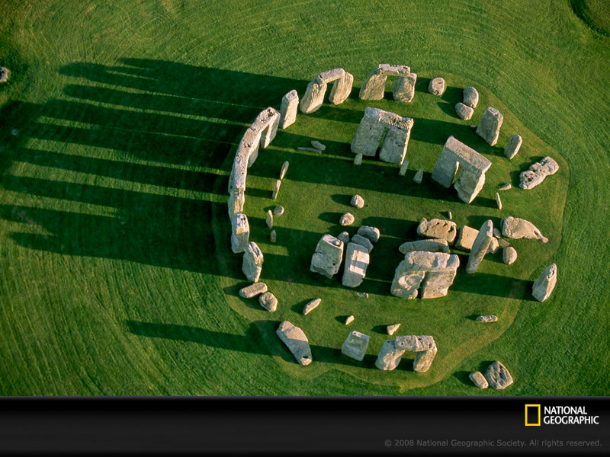
To put it in perspective…

Slide 8
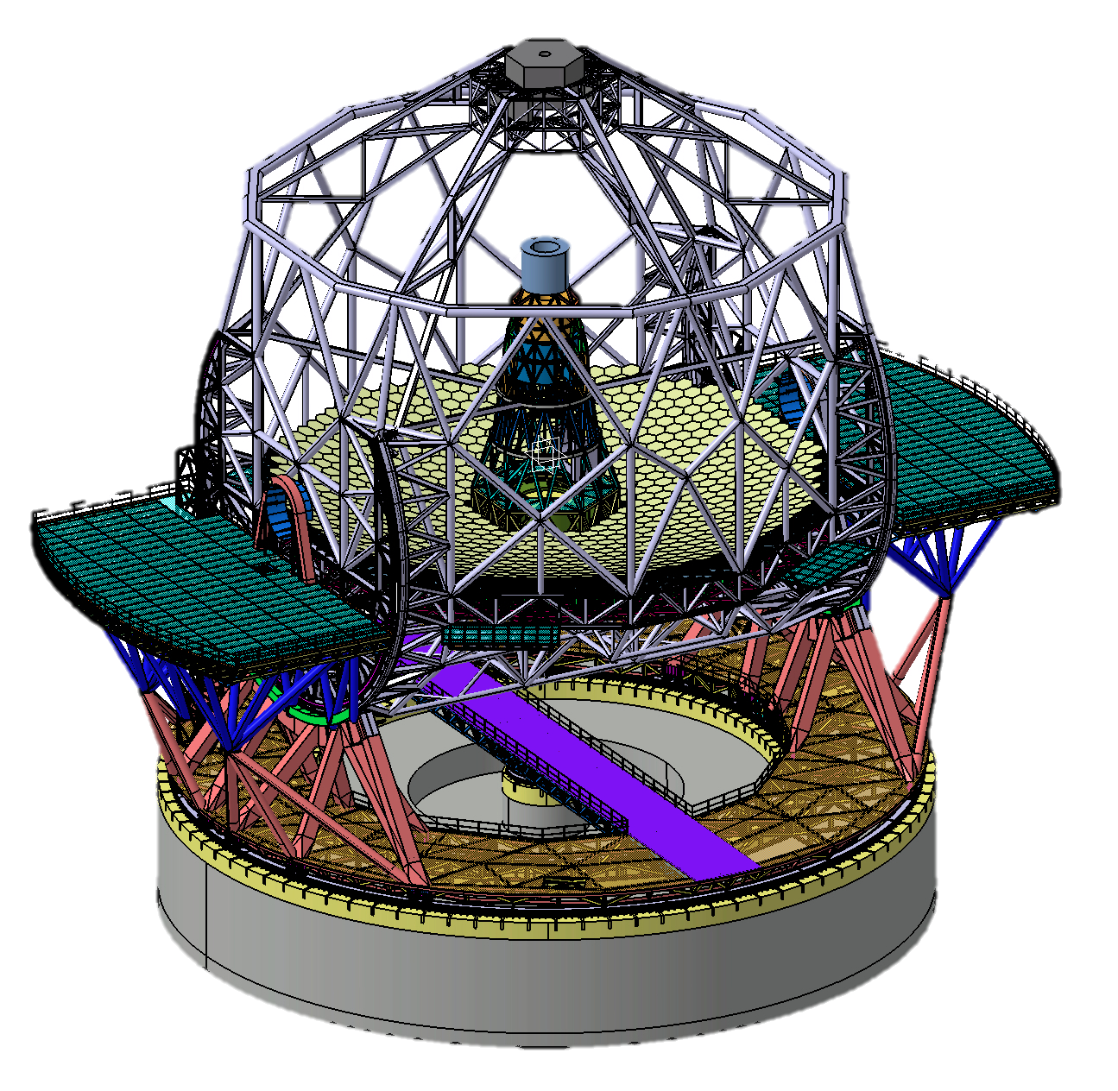
The E-ELT: overview

Slide 9

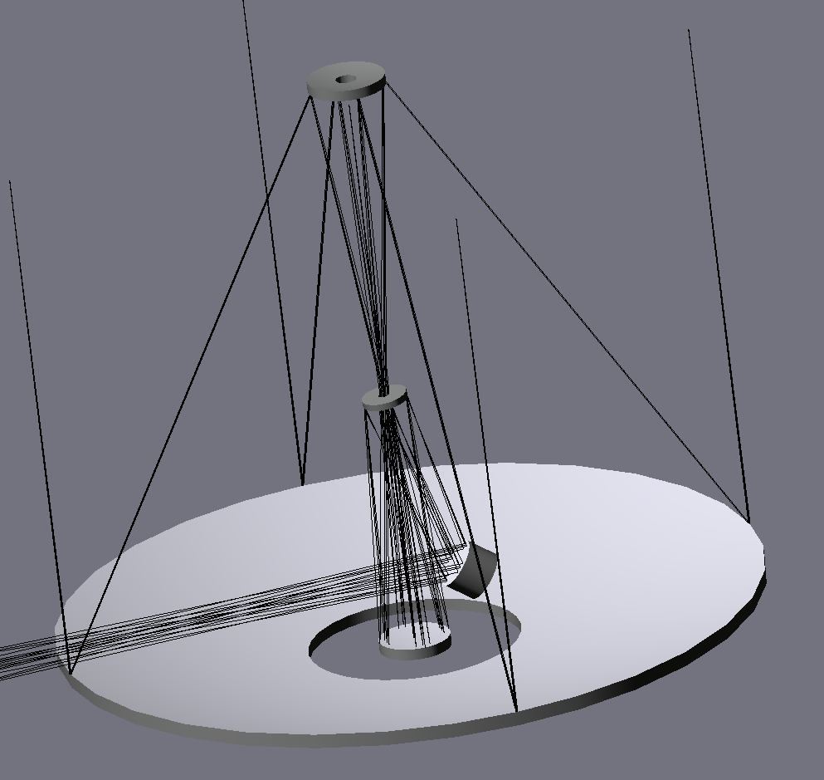
The E-ELT: overview
Optical design
3-mirror anastigmat on axis + 2 flats
diffraction limited over full 10′ FoV Nasmyth, coudé foci
very low LGS wavefront aberrations
Secondary Mirror M2
Quaternary Mirror M4
(adaptive)
Fifth Mirror M5
(tip tilt correction)
Tertiary Mirror M3
F/17.5 Focus
Primary Mirror M1

Slide 10
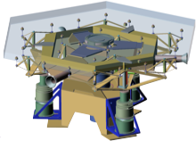
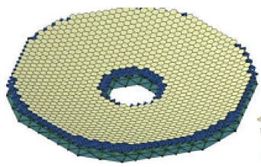
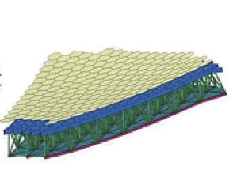
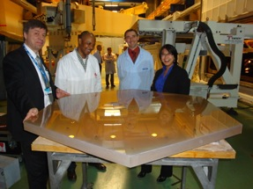
The E-ELT: overview
39m Primary Mirror
798 segments mirror +1/family
2 x 7 prototypes FEEDs
prototype support, PACTs, edge sensors
Prototype segments

Slide 11
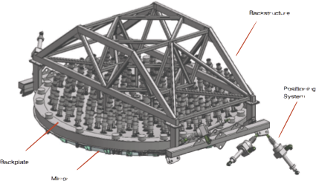
The E-ELT: overview
4m Secondary Mirror
M2 unit FEED
3 polishing studies
prototype actuators

Slide 12
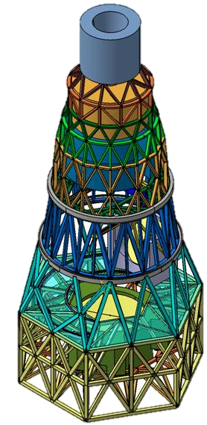
The E-ELT: overview
Central tower
ADC volume
Adaptive M4
Field stabilization M5
M3

Slide 13
The E-ELT: overview
ADC volume
M4 mirror
M5 mirror
M3 mirror

Slide 14
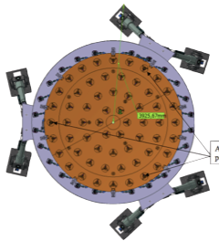
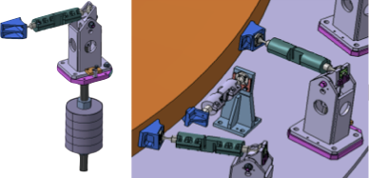
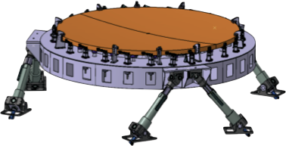
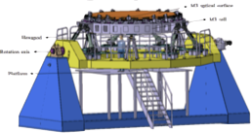
The E-ELT: overview
4.2m M3 unit
Preliminary cell design concluded
Prototype pneumatic actuators

Slide 15
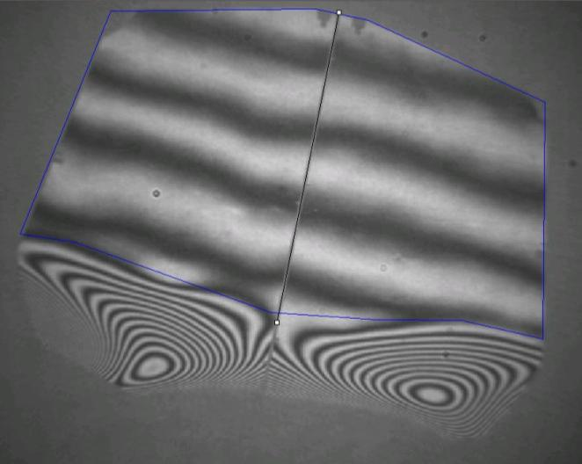
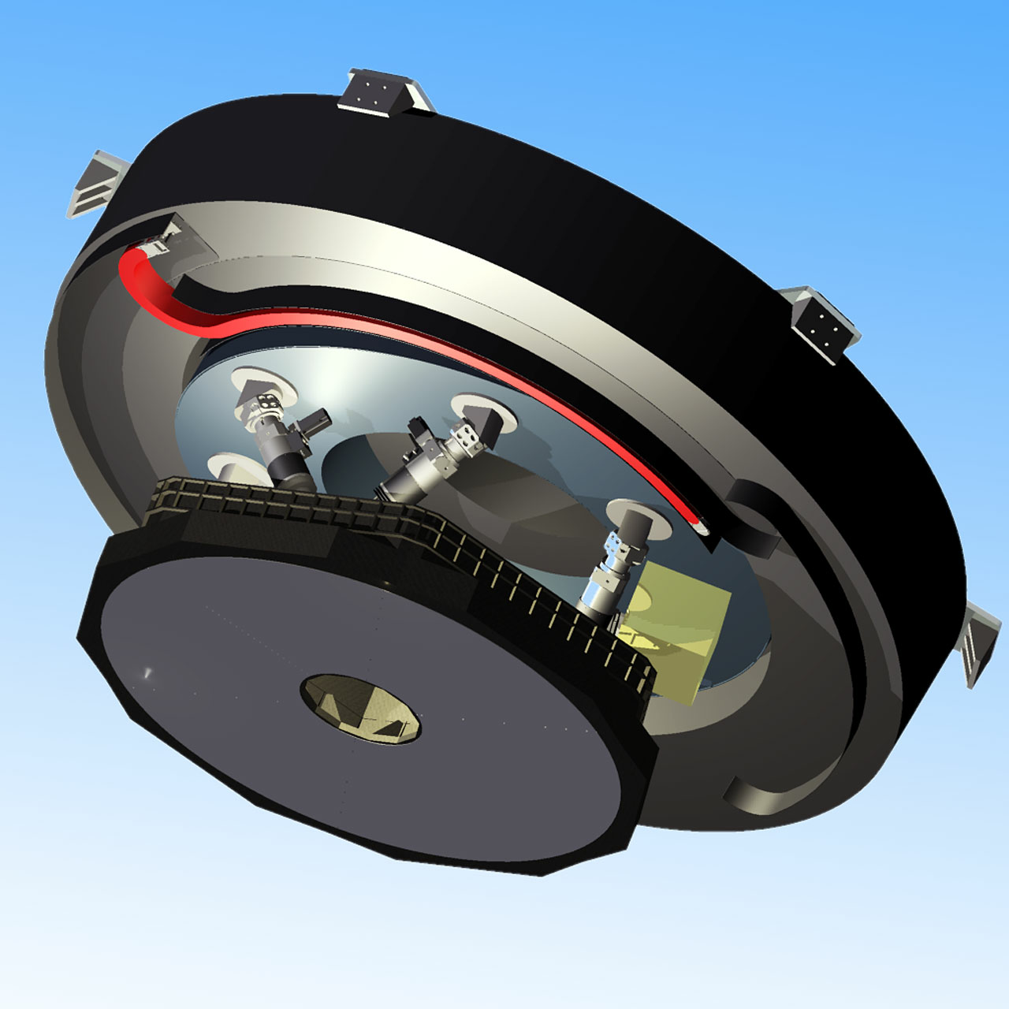
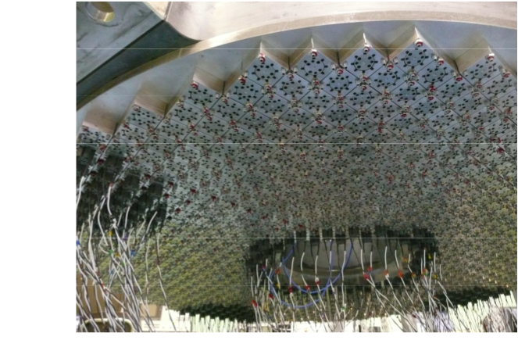
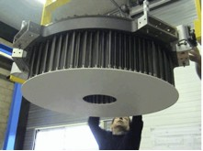
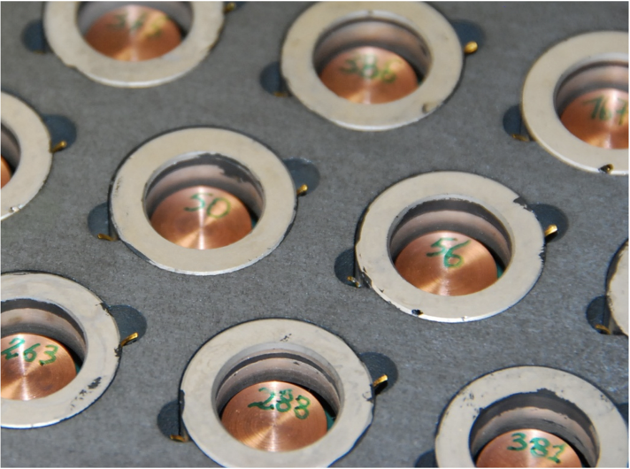
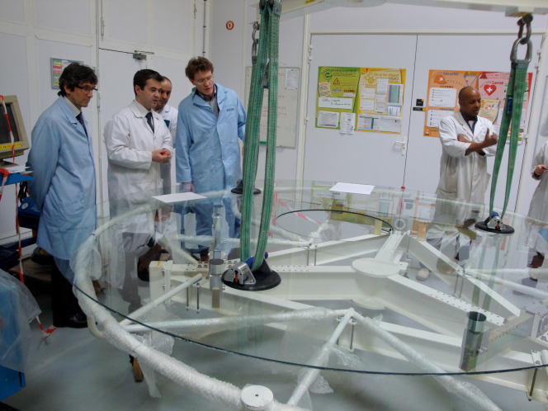
The E-ELT: overview
2.5m M4 unit
2 FEEDS (prototypes)
Thin shells polishing
Contract to PDR with AdOptica (ADS/Microgate)

Slide 16
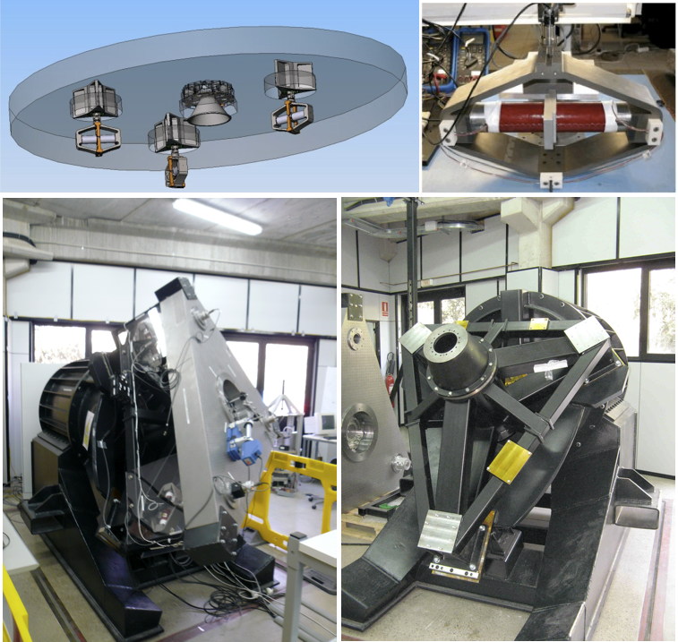
The E-ELT: overview
2.4m x 3m M5 unit
scale-1 electromechanical prototype FEED
final stages of testing
4 mirror polishing studies (including heavy option)

Slide 17
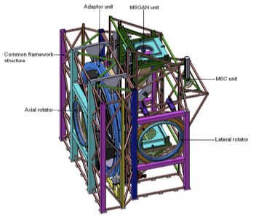
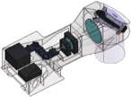
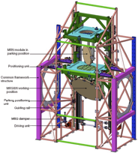
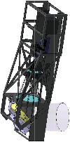
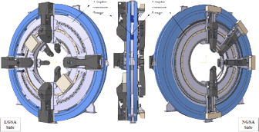
The E-ELT: overview
Prefocal station
on-going work this summer

Slide 18
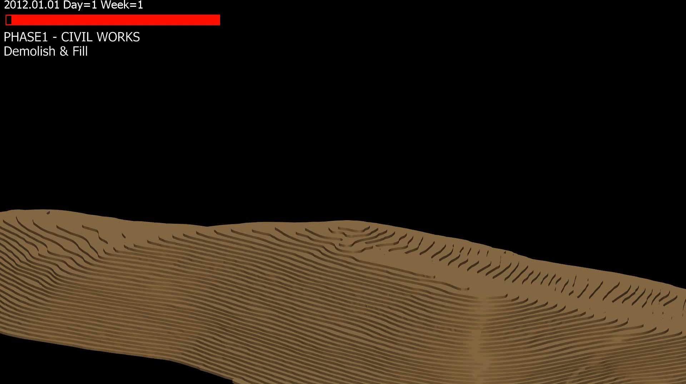
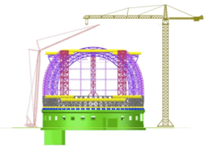
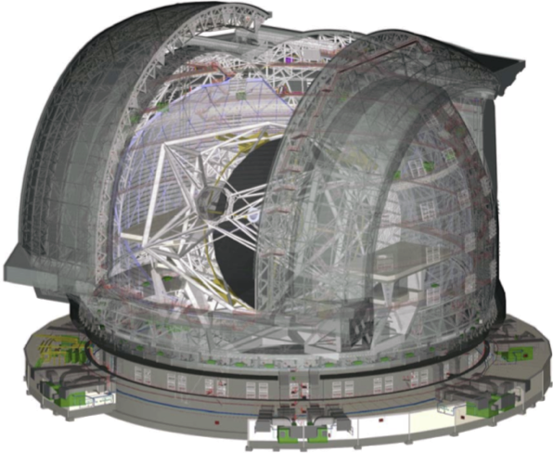
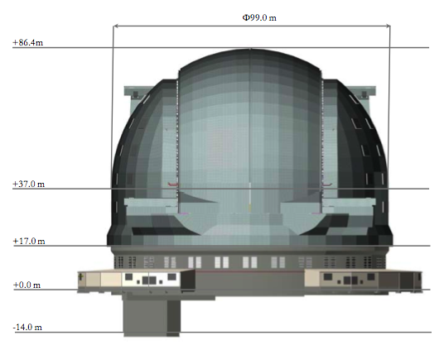
The E-ELT: overview
Dome
2 FEED contracts
Erection sequence

Slide 19
The E-ELT: overview
Instrumentation
8 instrument concepts Phase A concluded
2 post-focal AO modules Phase A concluded

Slide 20
The E-ELT: overview
First Light Instruments

Slide 21
Instrument Roadmap
Endorsed by STC & Council
7 instruments currently identified for construction
Construction proposal covers first four instruments
  Others funded from operations
Project Science Team leadership in science requirements definition
Notes:
Note this is pasted in as enhanced metafile, so cant edit it. Its copied from the instrument chapter so if needed edit that one.

Slide 22
Construction Proposal Schedule
Start assumed Jan 2012
AIV Starts Jan 2020
Technical First Light Dec 2021
First Instrument “Sky Ready” Jun 2022
Observatory Operations Oct 2022

Slide 23
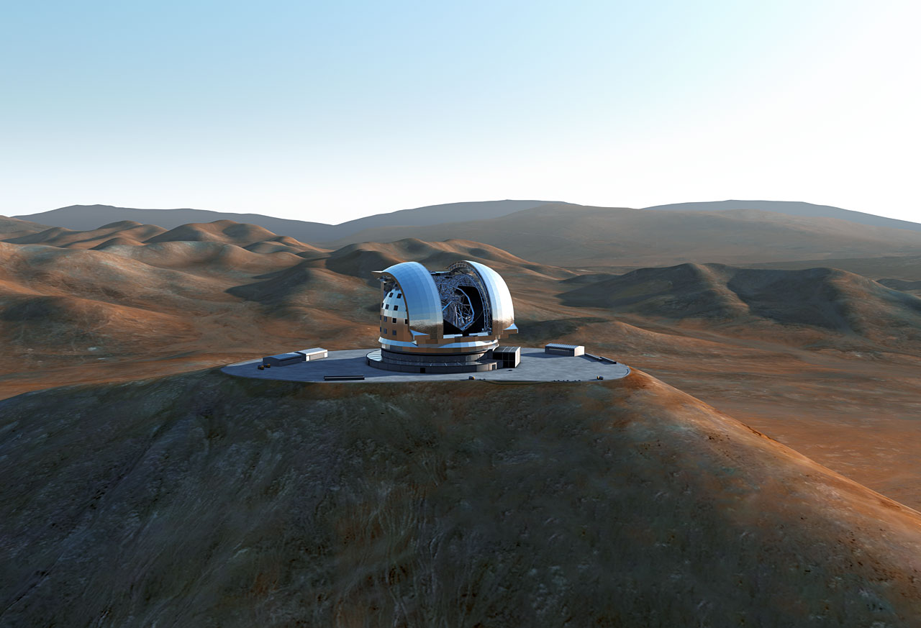
Next Steps
Project Manager now in place, offer out to Project Engineer
In December 2011 Council established that E-ELT could start once 90% of the budget is in place
Several Member States have the additional money in place
Formally E-ELT will be a supplementary programme for ESO and its approval requires a 2/3^{rds} majority (10 yes votes)
Approval at Council next week!

