Slide 1
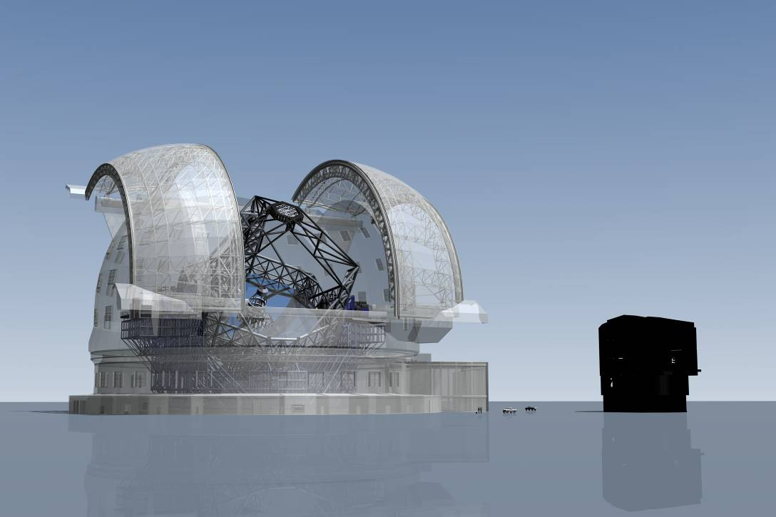
HARMONI – the first light integral field spectrograph for the E-ELT
Niranjan Thatte
On behalf of the HARMONI consortium
E-ELT
VLT
Special thanks to M. Tecza, F. Clarke, D. Montgomery

Slide 2
HARMONI at the E-ELT

Slide 3





HARMONI Consortium
Niranjan Thatte, Matthias Tecza,
Fraser Clarke, Roger Davies, Tim Goodsall, David Freeman, James Lynn, Harry Smith.
David Lunney, Hermine Schnetler, David Montgomery, Angus Gallie
Stewart McLay, Naidu Bezawada
Santiago Arribas
Adolfo García Marín
Fernando Gago Rodríguez
Anna Fragoso, Felix Gracia
Javier Fuentes, Dario Sosa,
Evencio Mediavilla
Roland Bacon
Alban Remillieux
Johan Kosmalski
Arlette Pecontal

Slide 4
A Single Field Wide Band Spectrograph
A near infrared integral field spectrograph covering the 0.8 − 2.4 μm wavelength range, with simultaneous coverage of at least one band at a time. R~4000 to work between the OH lines
Range of spatial resolutions from diff. limited to seeing
Possible extension to visible wavelengths and higher spectral resolution
High throughput (>35%), low thermal background (optimized for K band operation), low scattered light

Slide 5
Slicing the Image

Slide 6
Design Drivers
Spatially resolved detailed studies of astrophysical sources – physical, chemical, dynamical & kinematics; ultra-sensitive observations of point sources.
Easy to operate and calibrate
Feasibility for 1st light instrument => simple, reliable, based on proven concepts, can be built with today’s technology. Large amount of expertise in consortium
Workhorse instrument – wide range of science programs, all AO modes, range of spatial & spectral resolutions

Slide 7
20 mas
10 mas
4 mas
40 mas
Best combination of sensitivity and spatial resolution
Highest spatial resolution (diffraction limited)
For extended sources & optimal FoV
For optimal sensitivity (faint targets)
5” × 10”
128 × 256 spaxels at all scales
7
2.5” × 5”
f
1.25” × 2.5”
0.5” × 1.0”

Slide 8
Wavelength Ranges & Resolving Powers
Band | λ_{min}[µm] | λ_{max}[µm] | δλ [Å/pixel] | R
H+K | 1.450 | 2.450 | 2.500 | 3900
I+z+J | 0.800 | 1.360 | 1.400 | 3857
V+R | 0.470 | 0.810 | 0.850 | 3765
K | 1.950 | 2.450 | 1.250 | 8800
H | 1.460 | 1.830 | 0.925 | 8892
J | 1.080 | 1.360 | 0.700 | 8714
I+z | 0.820 | 1.030 | 0.525 | 8809
R | 0.630 | 0.790 | 0.400 | 8875
V | 0.500 | 0.630 | 0.325 | 8692
K high | 2.090 | 2.320 | 0.575 | 19174
H high | 1.545 | 1.715 | 0.425 | 19176
J high | 1.170 | 1.290 | 0.300 | 20500
z | 0.820 | 0.910 | 0.225 | 19222
R high | 0.610 | 0.680 | 0.175 | 18428
V high | 0.530 | 0.590 | 0.150 | 18666

Slide 9
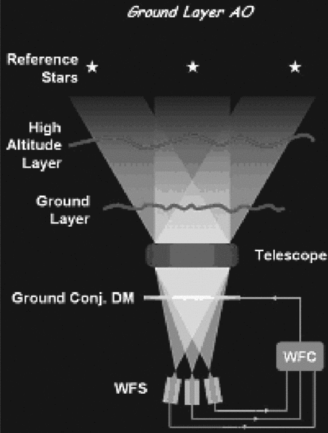
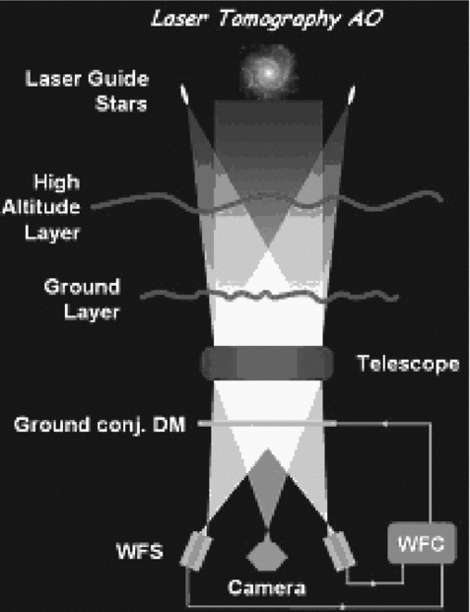
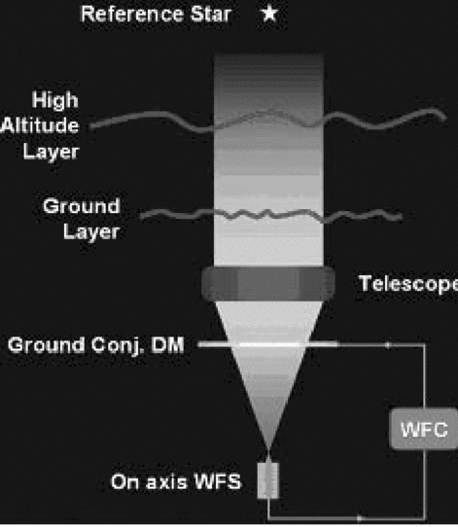
Different Flavours of AO
SCAO
GLAO
LTAO
Or even degraded GLAO (NGS only) !!!

Slide 10
Science Case & Requirements
Contributors: Roger Davies, Matthias Tecza, Santiago Arribas, Roland, Bacon, Fraser Clarke, Luis Colina, Eric Emsellem, Tim Goodsall, Isobel Hook, Matt Jarvis, Andrew Levan, John Magorrian, Livia Origlia, Rafael Rebolo, Dimitra Rigopoulou, Mark Swinbank, Nial Tanvir, Niranjan Thatte, Eline Tolstoy, Aprajita Verma.

Slide 11
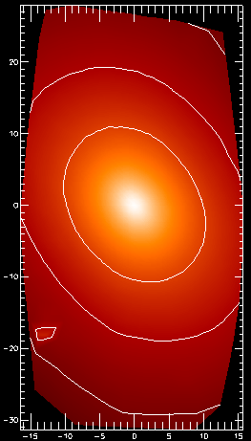
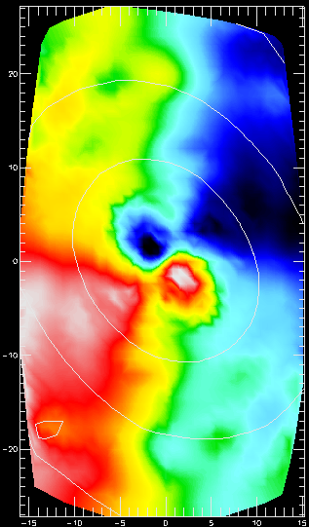
Scientific motivation
At the fine scale of E-ELT + HARMONI working in the diffraction limit there is enormous value in being able to reconstruct where, in a complex image, a spectrum arises.
Using AO in the infrared conditions change rapidly so that a simultaneous recording of all positions and wavelengths removes ambiguities.
At high z there are many more morphologically complex, low mass objects. Fine angular resolution and high spectral resolution are needed.
IFU records PSF from observations (if FoV contains a point source eg. quasar BLR).

Slide 12

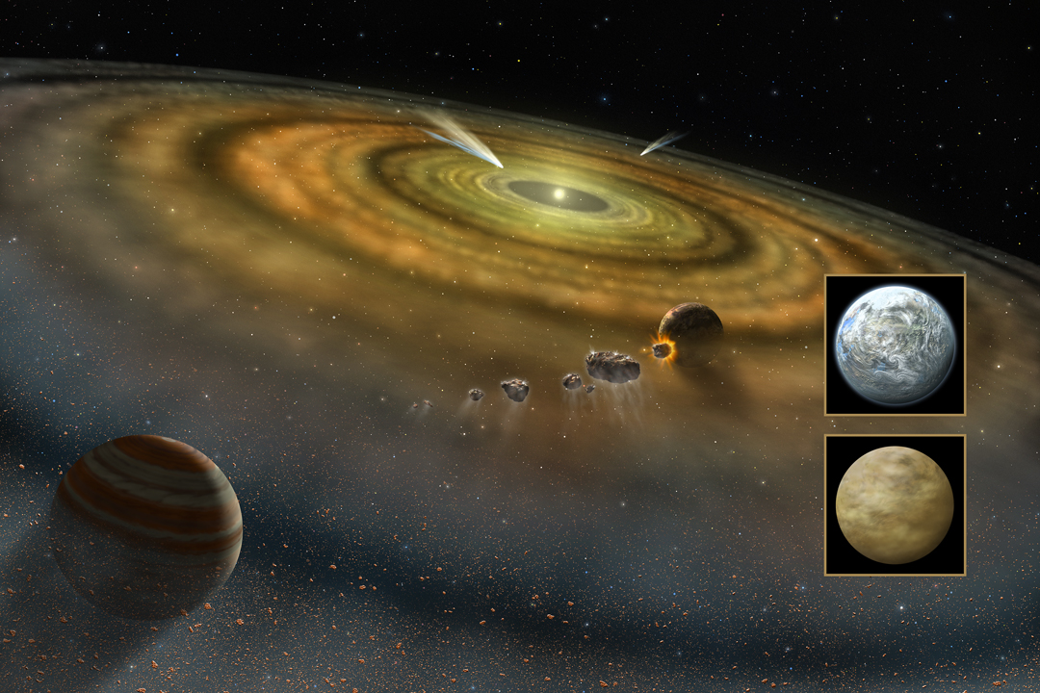
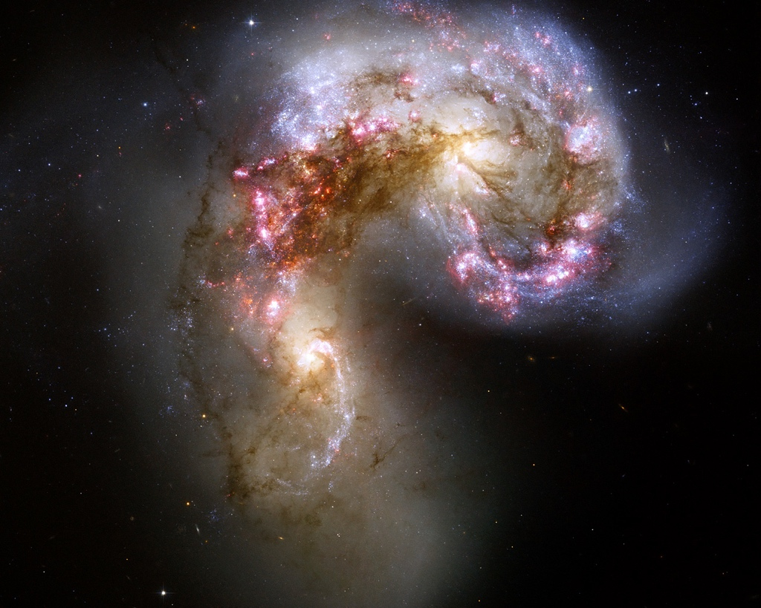
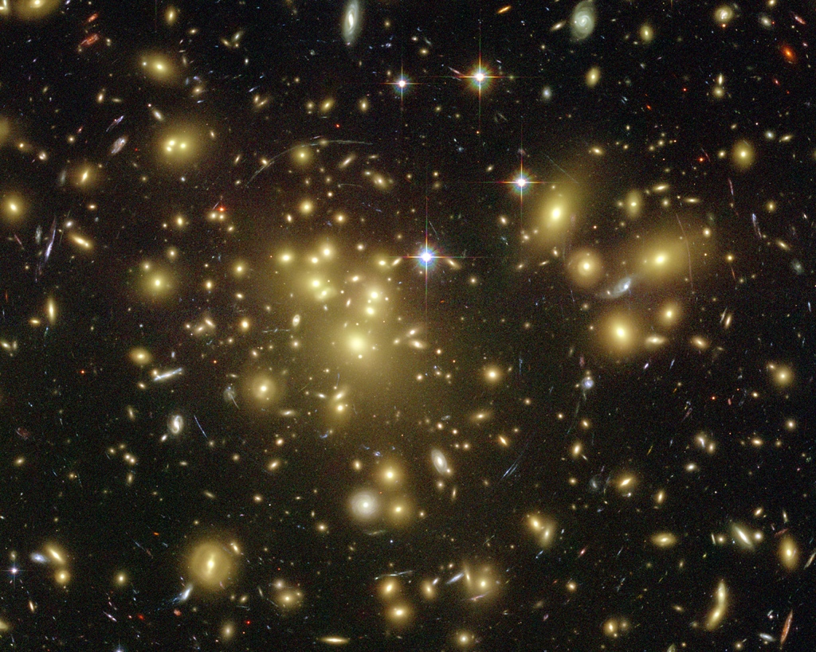
Contemporary Science
Planets & Stars
Stars & Galaxies
Galaxies & Cosmology

Slide 13
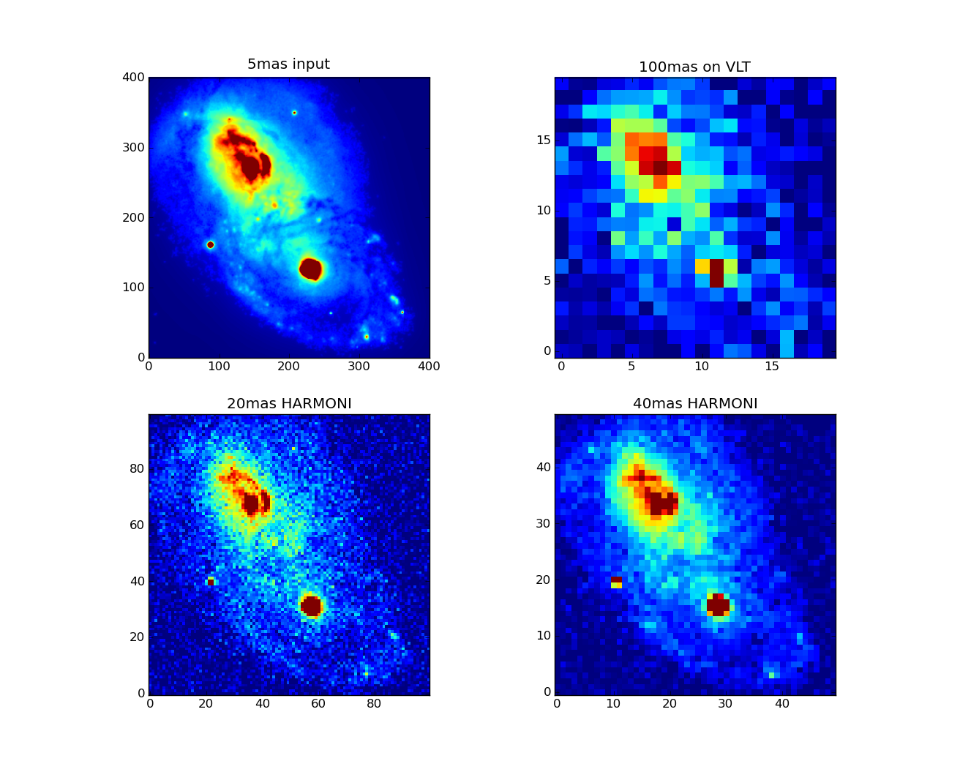
High-z Ultra-luminous IR Galaxies
Survey 50 Spitzer candidate ULIRGs 1<z<2.5
Detect & characterise nuclear disks & rings
Measure shocks, winds, interaction with IGM
Measure dynamical masses
Measure rotation (kinematics), chemical composition (fraction of heavy metals)
Modes of star formation
Distribution of dust
Hα in z=2 ULIRG
Requires: diffraction limited R > 4000 spectra,
spaxels 5-40mas. @ λ 0.5 - 2.5μ.

Slide 14
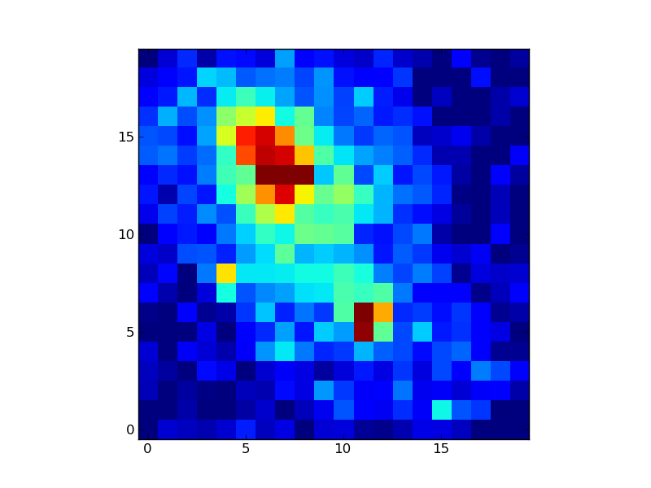
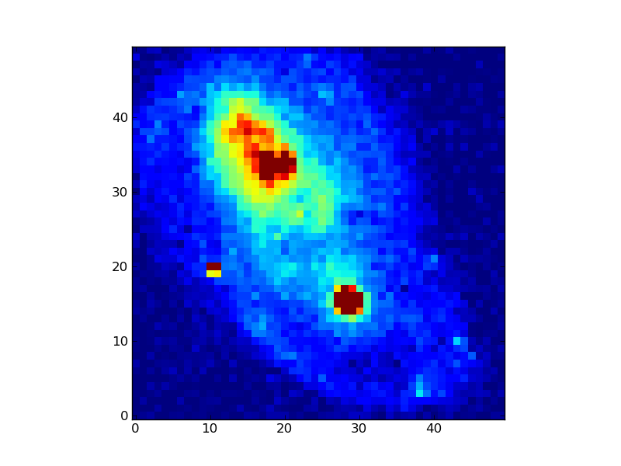
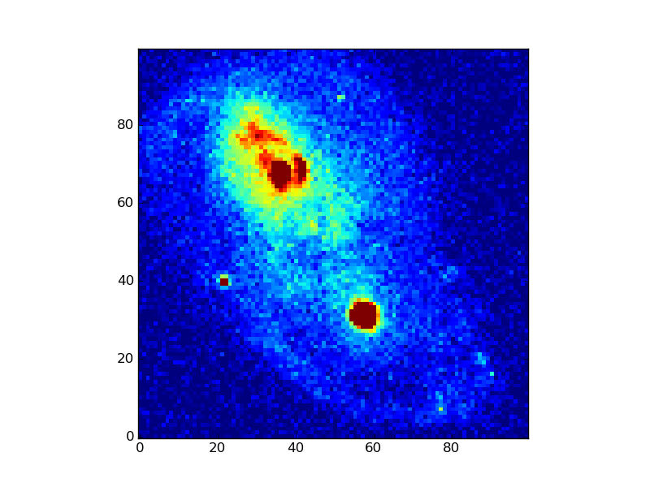
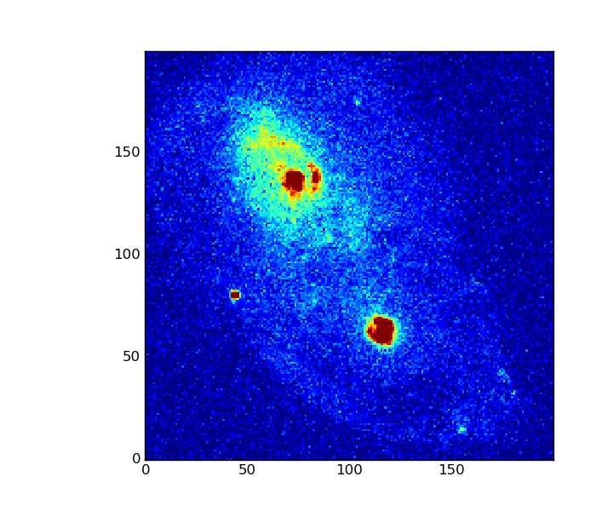
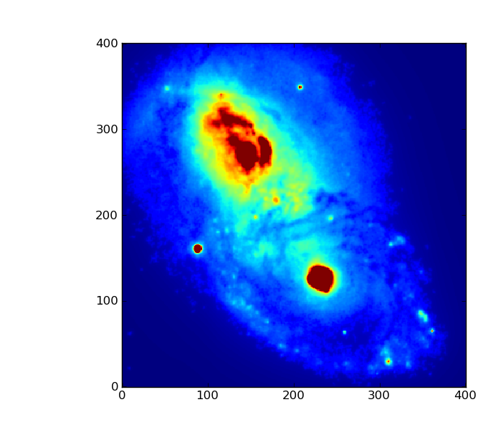
Compromise between sensitivity & resolution
5mas per pixel input
10 mas HARMONI scale
20 mas HARMONI scale
40 mas HARMONI scale
100 mas scale on VLT
D⁴ gain!
Notes:
Figure 31: This figure shows the results of our simulations showing the exquisite detail HARMONI will achieve for a typical LIRG at z~2 observed with LTAO.
The line-maps are created by integrating the simulated data-cube around the H-alpha emission line (in the K-band at this redshift).
The five panels show the original high-resolution image corresponding to a 5 mas per pixel scale, observations with the 10, 20, 40mas HARMONI scales
and finally as observed on the VLT with a 100mas scale (SINFONI).
14

Slide 15
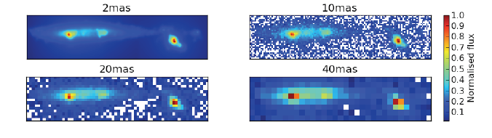
The Physics of High Redshift Galaxies z=2-5
Aim: measure the size, velocity & luminosity distribution of HII regions
  HII regions as tracers of SFH, mass & mergers
  Reddening free estimate of star formation rate
  Measure abundances for individual SF regions
  Explore HII kinematics as diagnostic of disk settling.
Requires : R > 4,000 – 20,000 spectra
@ λ J+H & H+K simultaneously.
4 - 40mas spaxels FOV 0.5 x 1.0”; 5 x 10”.

Slide 16
From first light to the earliest galaxies
  The HARMONI Deep Field
  Detecting the formation of MW like galaxies at z=10.
  Pop III - the first stars
  Detect first enrichment of IGM
  What re-ionised the Universe?
Requires: R ~ 5000 spectra,
@ λ 0.8 - 2.5μ.
4 - 40mas spaxels;
FOV 0.5 x 1.0”; 5 x 10”.
Figure 3 from Yang et al. 2006, showing the cooling of Lyα (top)
and HeIIλ1640 (bottom) for an 11Mpc simulation at z~3. Lyα is more
diffuse whereas HeII appears as compact points sources, this suggest
HeII is a promising tracer of concentrations of dark matter.

Slide 17
Stars & Galaxies
Imaging and spectroscopy of extragalactic resolved stellar populations
Studies of black holes and active galactic nuclei (AGN)

Slide 18
Stellar Populations: star formation history, chemical & dynamical evolution.
Measure the line of sight velocities and heavy element content of individual stars in local group, Fornax and Virgo clusters, so as to be able to decompose the stellar populations into thick disk, thin disk, bulge and halo.
This takes stellar population studies into a completely unexplored realm.
Requires: R= 9000 & 20,000 spectra,
20mas spaxels @ λ 0.6 - 1.0 & 1.0 - 2.5μ.

Slide 19
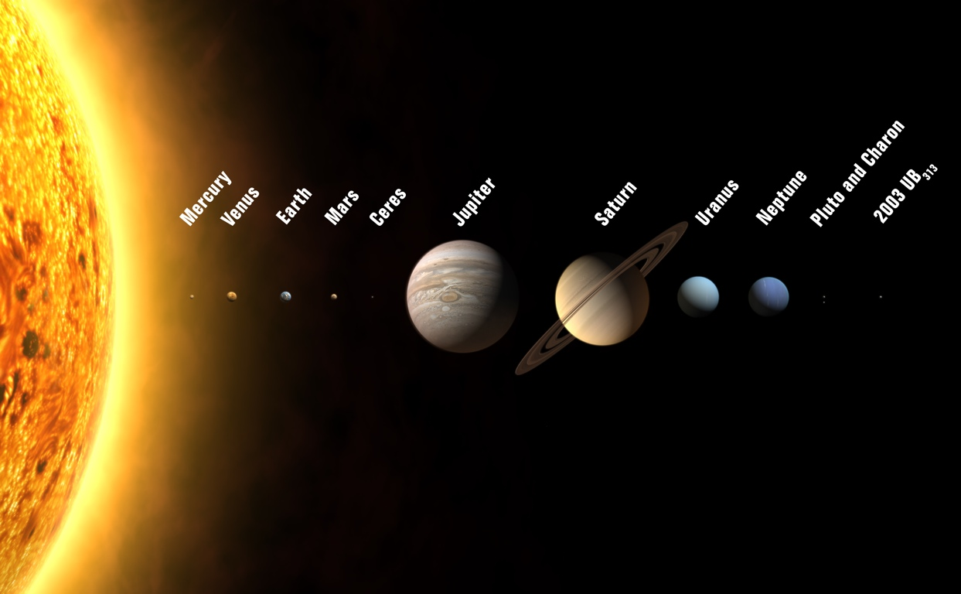
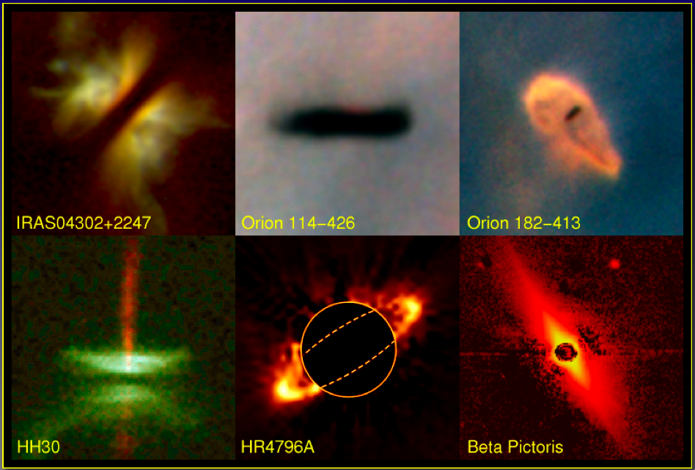
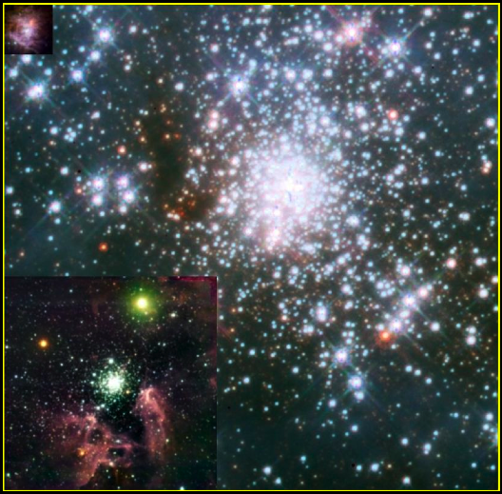
Planets & Stars
From giant to terrestrial exo-planets:
Direct detection via high-contrast imaging
Indirect detection via radial velocity variations
Circumstellar disks
Young stellar clusters and the initial mass function

Slide 20
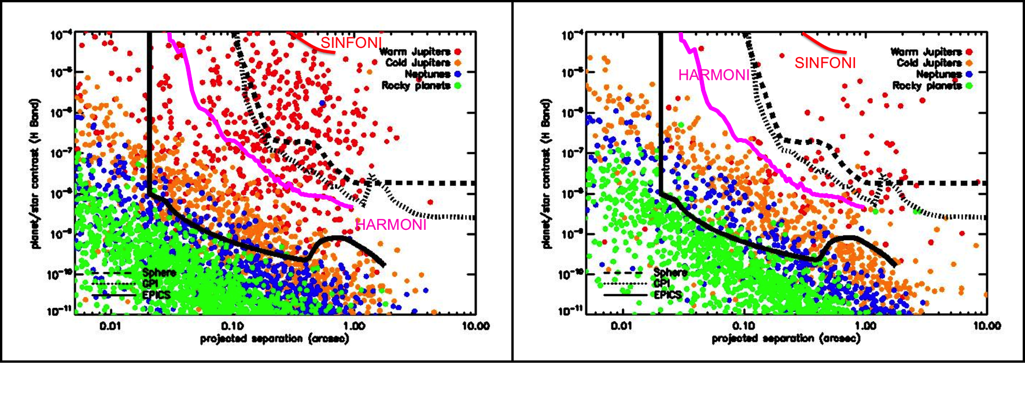
High Contrast Science – Characterising Exo-solar Planets
Aim: follow-up spectroscopy of candidate exo-solar planets seen by VLT
  Spectral lines provide measure of surface gravity
  Combine with other techniques to get density, temperature and luminosity.
  Clues to atmospheric composition – constrain models
Young stars
Nearby stars
Requires : R > 4,000 – 20,000 spectra @ I+z+J, H+K
simultaneously. 4 mas spaxels, FOV 0.5 x 1.0”; SCAO.

Slide 21
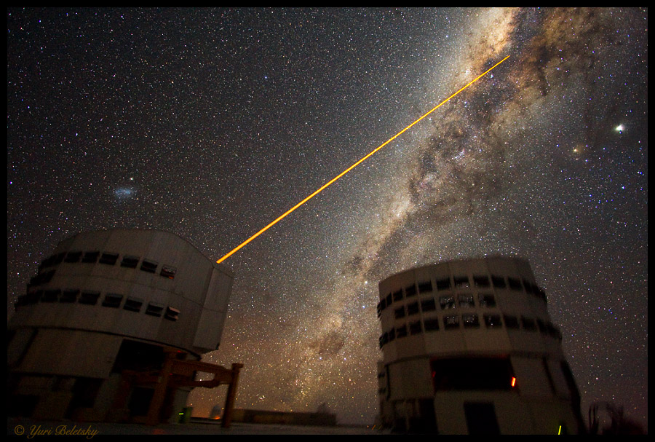
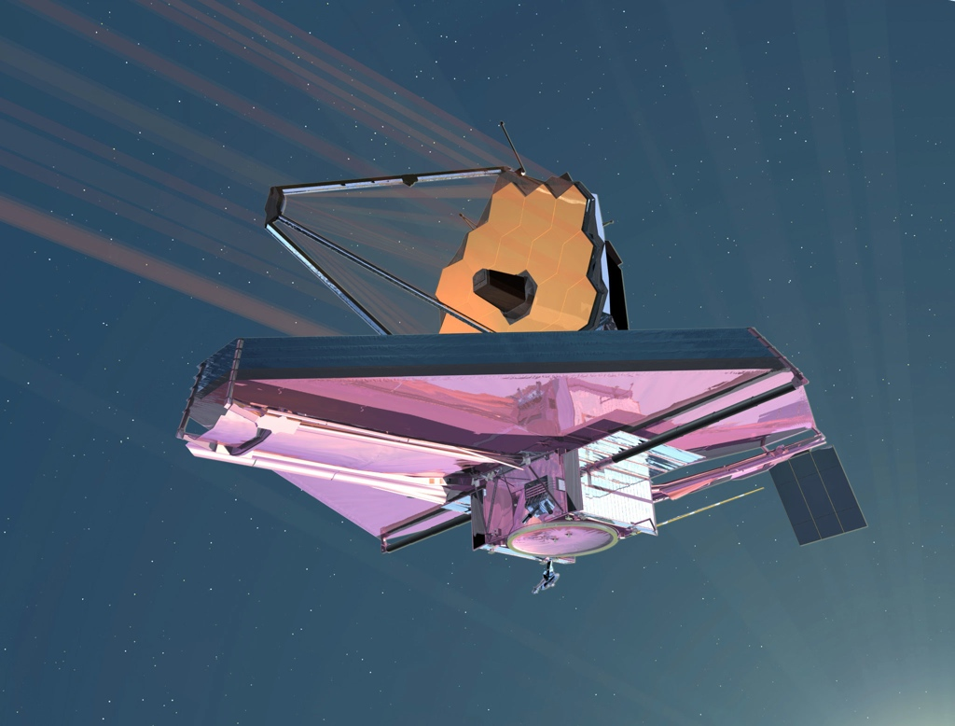
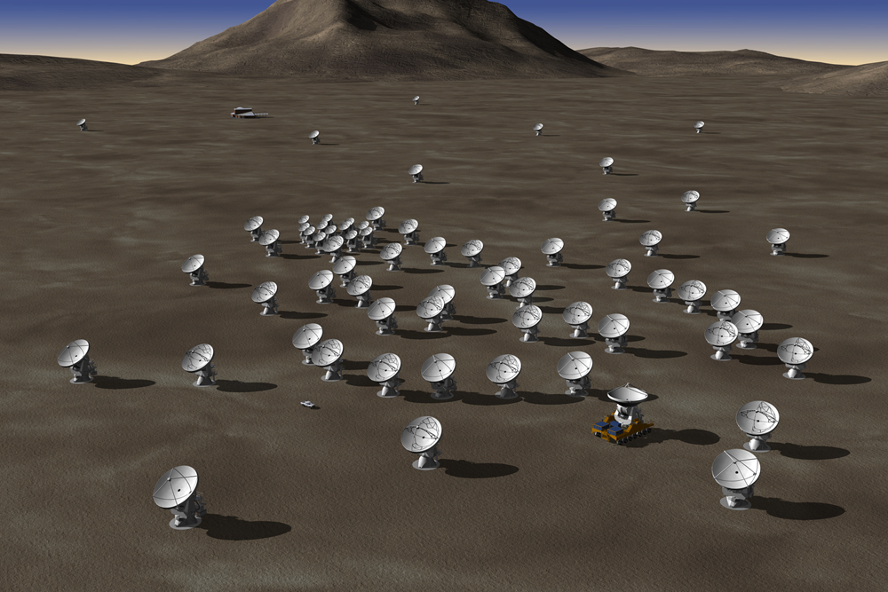
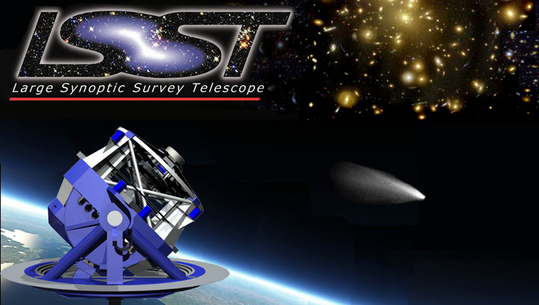
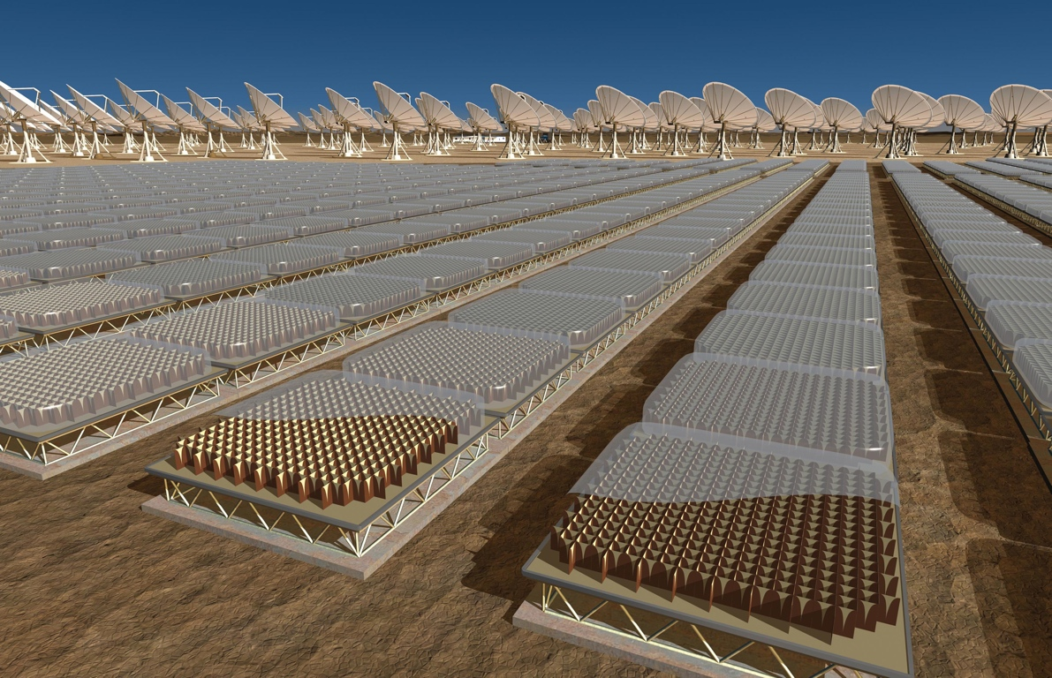
Synergy with Large Facilities
The 8-10m class Telescopes (VLT/I, ...)
The JWST
ALMA
LSST
SKA / SKA Pathfinders
...

Slide 22
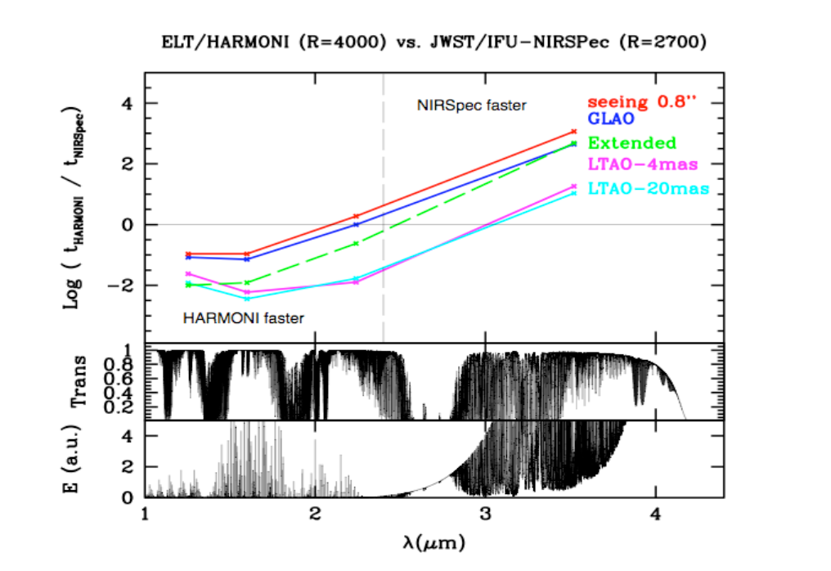
HARMONI vs. JWST NIRSpec
At J & H E-ELT + HARMONI even in natural seeing HARMONI is 10× faster.
Using LTAO and for extended sources the advantage rise to × 100.
At K-band the advantage is retained with LTAO. With GLAO & natural seeing the two facilities are comparable, HARMONI wins at the blue end of K.
Note that both NIRSpec and HARMONI offer other, less comparable capabilites where they have a greater advantage.
page 22

Slide 23
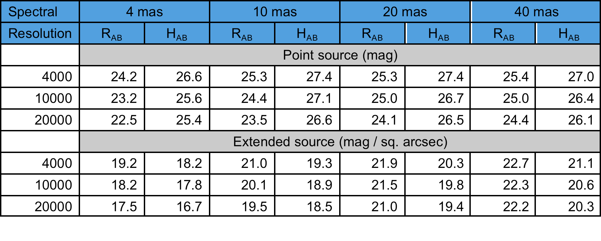
Sensitivity
20 mas spaxels provide best sensitivity for point sources
40 mas spaxels best for extended sources

Slide 24
Size, Weight, Cost & Schedule
12 tons
4.2m × 5.0m footprint
6.8 m in height
209 person-years
10.52 M€
7 yr build phase

Slide 25
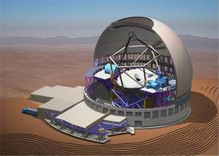
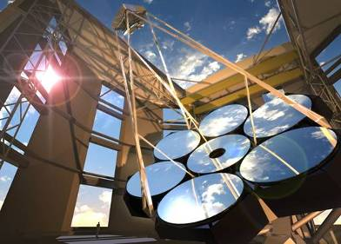
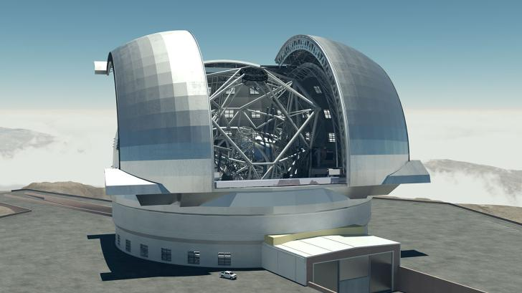
The Competition
Thirty-Meter Telescope
Giant Magellan Telescope - Carnegie Observatories Artwork by Todd Mason
European ELT

Slide 26
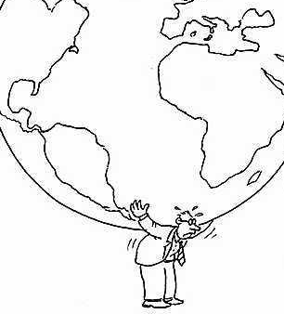

Challenges
Large instrument size and mass makes handling difficult
HARMONI Integration Laboratory
HARMONI
Cryostat
HARMONI
PI

Slide 27
Challenges
Large instrument size and mass makes handling difficult.
Managing large consortia requires professional approach, implies larger management overhead.
Time is precious – efficient operations, long MTBF, simple user interface, preparation software.
Track every item through design, manufacturing, assembly, integration and testing – take nothing for granted

Slide 28
10€ / second!!
If there a mechanism you use once per hour, 10 hrs/night, 60 nights/year, 15 years = 9000 operations
Each second saved = 90000 € over instrument lifetime!
If each additional staff year spent shaves of 10 seconds for an acquisition sequence, pays for itself handsomely over instrument lifetime

Slide 29
