Slide 1
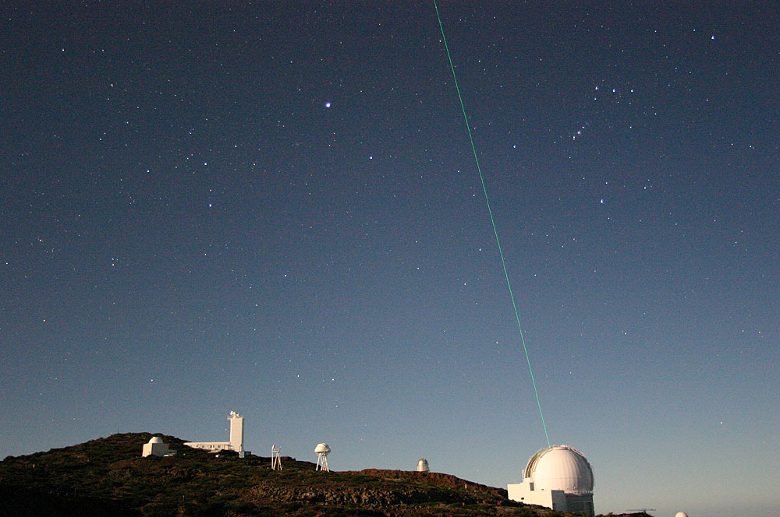

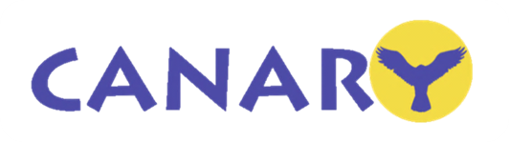
CANARY
The LGS AO Demonstrator at the WHT
Tim Morris (Durham University)
and
The CANARY team

Slide 2
Contents
Tomography in Adaptive Optics
Multiple Object Adaptive Optics
CANARY Status and Results
Impact on future AO systems

Slide 3
Adaptive optics
Technique for the correction of images distorted by the passage of light through a turbulent medium
Restores telescope resolution, concentrates light to allow shorter exposures
After AO
Before AO

Slide 4
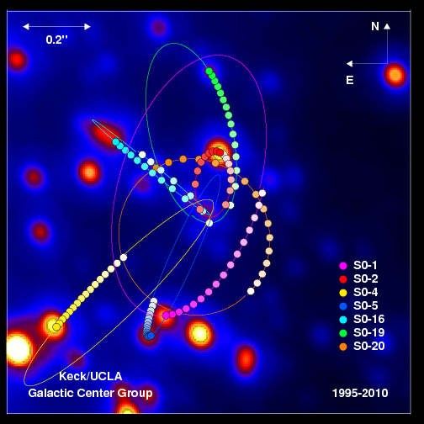
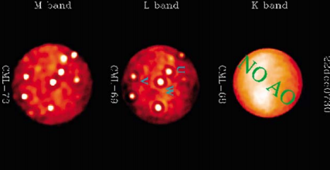
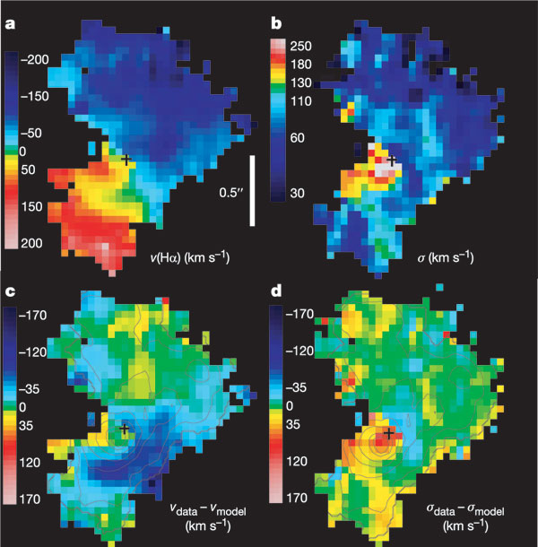
AO Systems to date
1
First generation systems suffered from low sky coverage and narrow field of view
  Complex to use and understand
  Still produced interesting (if sparse) results
Second/third generation systems improved sky coverage (LGS), more reliable and were able to cope with varying atmospheric conditions.
Field of view remains a problem…
2
3
See e.g. Ghez et al ApJ 689, 1044 (2008)
Genzel et al, Nature 442, 786-789 (2006)
Marchis et al, Icarus 176, 96-122 (2002)

Slide 5
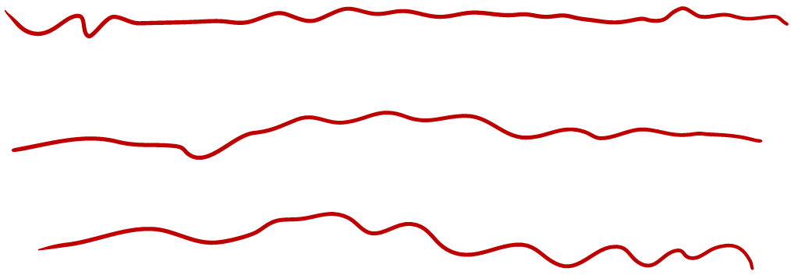
How does tomography help AO?
Closed loop control

Slide 6
How does MOAO differ?
Open loop control

Slide 7
CANARY Project
Create a single MOAO channel (resembling EAGLE as closely as possible) using the 4.2m William Herschel Telescope
  Effectively a 1/10th scale model of E-ELT using 4x 10km Rayleigh LGS to emulate >80km Na LGS
Perform NGS, then LGS based tomographic WFSing
Perform open-loop AO correction on-sky
Develop calibration and alignment techniques
Fully characterise system and subsystem performance
No requirement to deliver astronomical science

Slide 8
Phase A : NGS MOAO
Components:
  Low-order 8x8 DM
  3 x L3CCD open-loop NGS WFSs
  Open-loop optimised Fast Steering Mirror
  Hardware accelerated Real Time control system
  NGS MOAO Calibration Unit
10" science FOV
NGS WFS
NGS WFS
NGS WFS
Phase A: NGS MOAO
Science Verification
WHT
Nasmyth
GHRIL Derotator
NGS Pickoffs
NGS FSM
Low-order DM
2.5’ Derotated WHT field
Truth Sensor
Calibration Unit
3 x NGS WFS
Figure Sensor

Slide 9
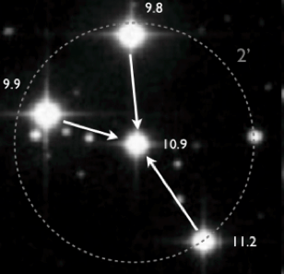
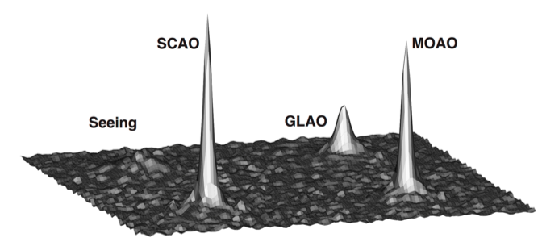
Strehl ratio comparison image
Seeing-limited (NoAO) (SR=1% at 00h59mn)
GLAO (SR=9% at 00h42mn)
MOAO (SR=19.4% at 00h29mn)
SCAO (SR=23.8% at 00h32mn)
Images recorded at a central wavelength of 1.495µm

Slide 10
Terms of the error budget
σ²tomo
Tomographic error
σ²OL
Open loop error (go-to error)
σ²tomonoise
noise propagated throught reconstructor on the DM
σ²aliasing
Aliasing correlated (ground) and not correlated (alt)
σ²BW
Bandwidth error (temporal error)
σ²fitting
Fitting error
σ²statbench
internal Strehl (best SR on bench without turbulence)
σ²static
MOAO measured telescope+Canary field static aberrations
σ²noiseTS
Noise on Truth Sensor
σ²others
???

Slide 11
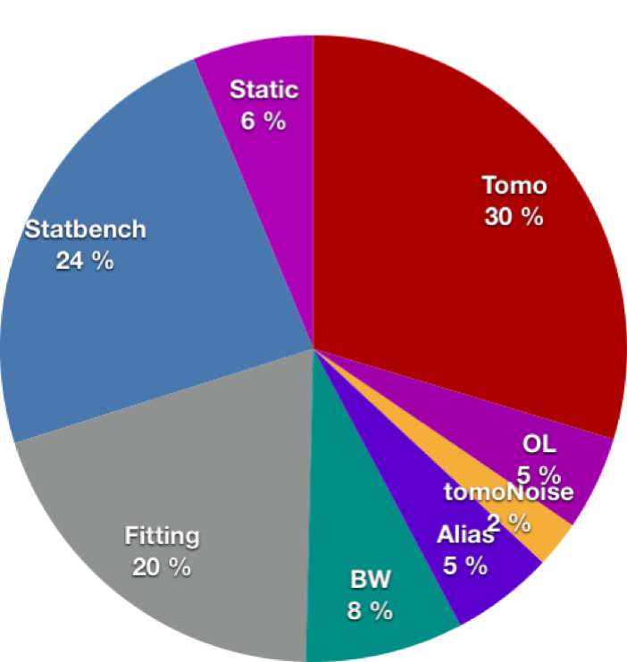
From synchronised data at 00h10mn12s (Asterism #47)
Error | Estimated value (nm rms)
σ²tomo | 168
σ²OL | 68
σ²tomonoise | 48
σ²aliasing | 71
σ²BW | 88
σ²fitting | 137
σ²statbench | 150
σ²static | 77
Total | 308
7 seconds of data (fe=150Hz)
r0=16.3cm (0.69’’ seeing)
Expected SR = 19.0%@1.49µm => measured = 21%

Slide 12
Phase B: Low-order LGS MOAO
GLAS BLT
Diffractive Optic
LGS Rotator
Lasers
Figure Sensor
3 x NGS WFS
WHT
Nasmyth
GHRIL Derotator
LGS Dichroic
NGS FSM
Low-order DM
NGS Pickoffs
1.0’ Diameter LGS asterism
LGS Pickoffs
Calibration Unit
Science Verification
Truth Sensor
LGS
FSM
Phase B: Low-order LGS MOAO
4 x LGS WFS
Adds four open-loop LGS WFSs to the existing three NGS WFSs
Can run in LGS or NGS modes or a mixture of both
Crucial for demonstrating EAGLE
LGS WFS

Slide 13
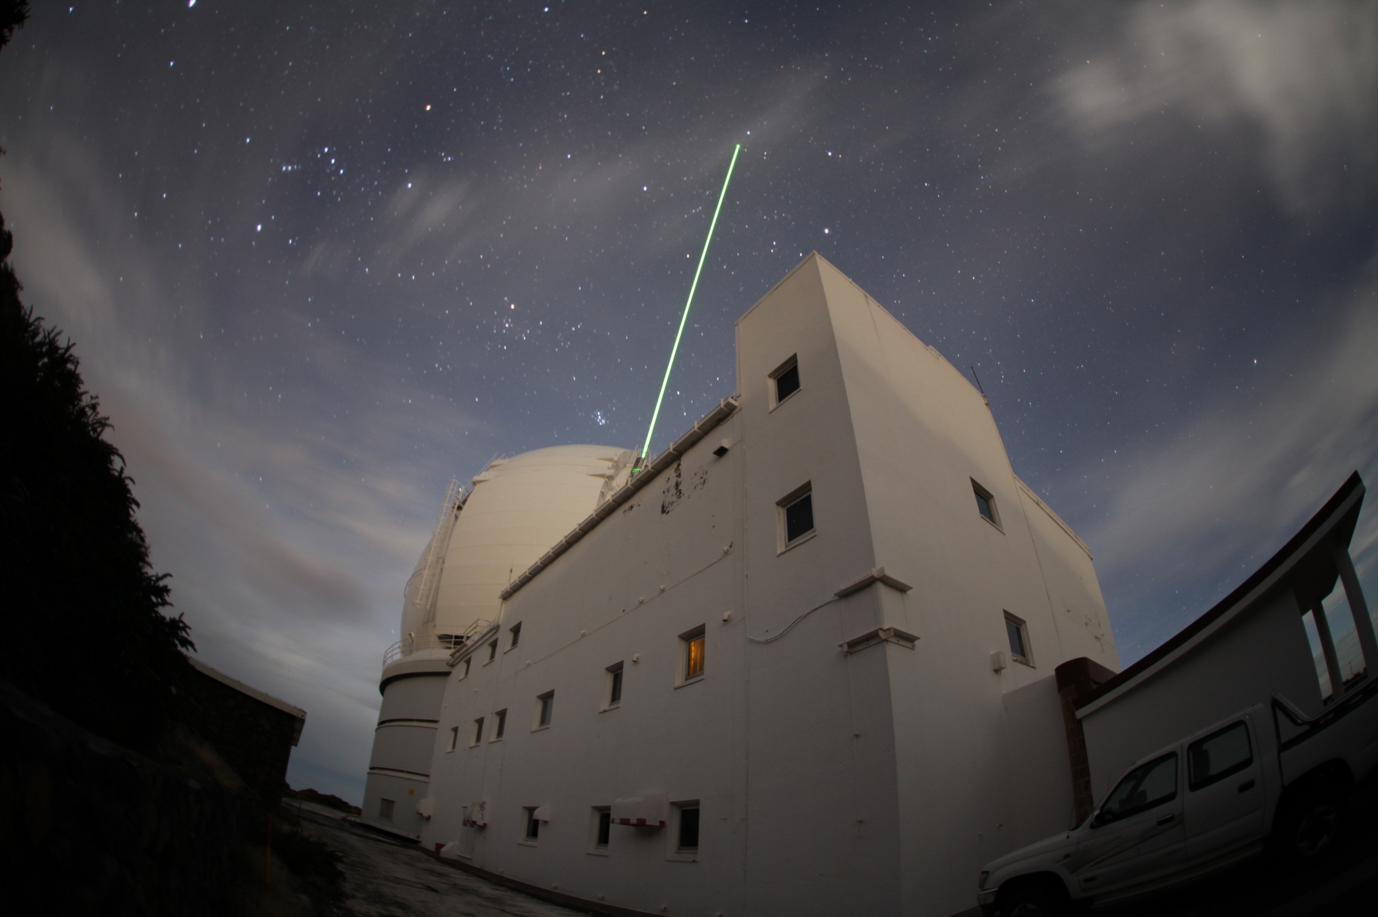
March/april 2012 commissioning

Slide 14
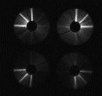
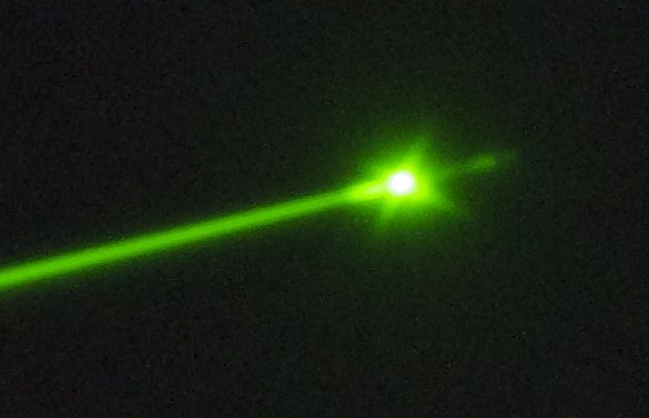
March/April 2012 commissioning
LGS launch system commissioned without full CANARY system
Test setup at the Nasmyth platform
Interfaces to telescope (beam steering, beam combination, launch system control, safety) commissioned
4 x LGS WFS optics tested
Single LGS Pockels cell range gate shutter tested
LGS fratricide for a 4 guide star asterism mapped
Diffraction spikes from LGS asterism generator
Cloud layers

Slide 15
Phase B Status
System has been run on the bench using 1-3 NGS and/or 1-4 LGS
New range-gated detector ordered
Initial experiments will be run with 2-3 x NGS and 1 x LGS
  LGS can be positioned anywhere in the field for testing tomography
Laser launch system tested and interfaced to the WHT
2 nights on sky at the end of July
10 further nights between August and November
Being packed in Paris as I speak and shipped to La Palma on Friday…
But Phase B still doesn’t fully demonstrate MOAO in an E-ELT like configuration…

Slide 16
CANARY Phase C
Reconfiguration of the Phase B system to produce a system closely resembling the proposed EAGLE configuration
Tip/tilt, focus
Tip/tilt, focus
T
E
L
E
S
C
O
P
E
3
NGS
WFS
TS
DM
4
LGS
WFS
IR CAM
High orders
High orders

Slide 17
CANARY Phase C1 (2013/14)
GLAO/LTAO/SCAO
Tip/tilt, focus
T
E
L
E
S
C
O
P
E
3
NGS
WFS
TS
DM
4
LGS
WFS
IR CAM
High orders

Slide 18
CANARY Phase C2 (2014+)
MOAO/LTAO/GLAO/SCAO
Tip/tilt, focus
High orders
T
E
L
E
S
C
O
P
E
3
NGS
WFS
TS
DM
DM
4
LGS
WFS
IR CAM
High orders
Low orders

Slide 19
Why is this important now?
LGS-MOAO and LTAO haven’t been demonstrated
The E-ELT won’t work without AO
  Telescope vibrations, structure induced turbulence, etc., will mean you have to run with AO to get an image
  Even the active optics system is a 5-layer multi-conjugate system…
List of untested/untried techniques essential to E-ELT operation will be developed using CANARY is large…
    Open-loop wavefront control
    Pseudo open-loop tomography
    Effect of LGS fratricide and elongation under controlled conditions
    Split closed-loop woofer/open-loop tweeter control
    On-sky calibration techniques
    On-sky algorithm testing
    Mixed LGS/NGS tomography
    On-line turbulence profiling and system optimisation
    More…

Slide 20
How Does CANARY help?
CANARY is the only on-sky capable system in the world that has the same multi-DM + WFS configuration that is proposed for the E-ELT
It is the only AO system that can be reconfigured to add/remove hardware subsystems
Linux-based real-time control system allows easy implementation of new software/algorithms.
All of this is made possible by the unique infrastructure present at the WHT
    Large enough telescope to do tomography
    Large, gravity stable Nasmyth platform
    Laser guide star launch system
New collaborations (since Phase A results published) started with
    INAF Arcetri (LGS Pyramid wavefront sensors)
    Observatoire de Lyon (Fractal Iterative Method for wavefront reconstruction)
    ONERA/L2TI (LQG wavefront control)
    ESO/ATLAS team (Driver behind C1 configuration)
    ESO (Sodium LGS elongation study)
    GranTeCan (WFS interfacing and real-time control)

Slide 21
Conclusions
CANARY has shown that open-loop tomography works
  Predicted and actual on-sky performance match well (more work to be done on the comparisons though!)
  Error budget is complicated
Phase B will be on-sky in under 2 months and demonstrate split NGS/LGS tomography
CANARY installed at the WHT is the only system in the world that can perform on-sky investigation of many of the unsolved issues relating to E-ELT telescope and future AO instrument design

Slide 22
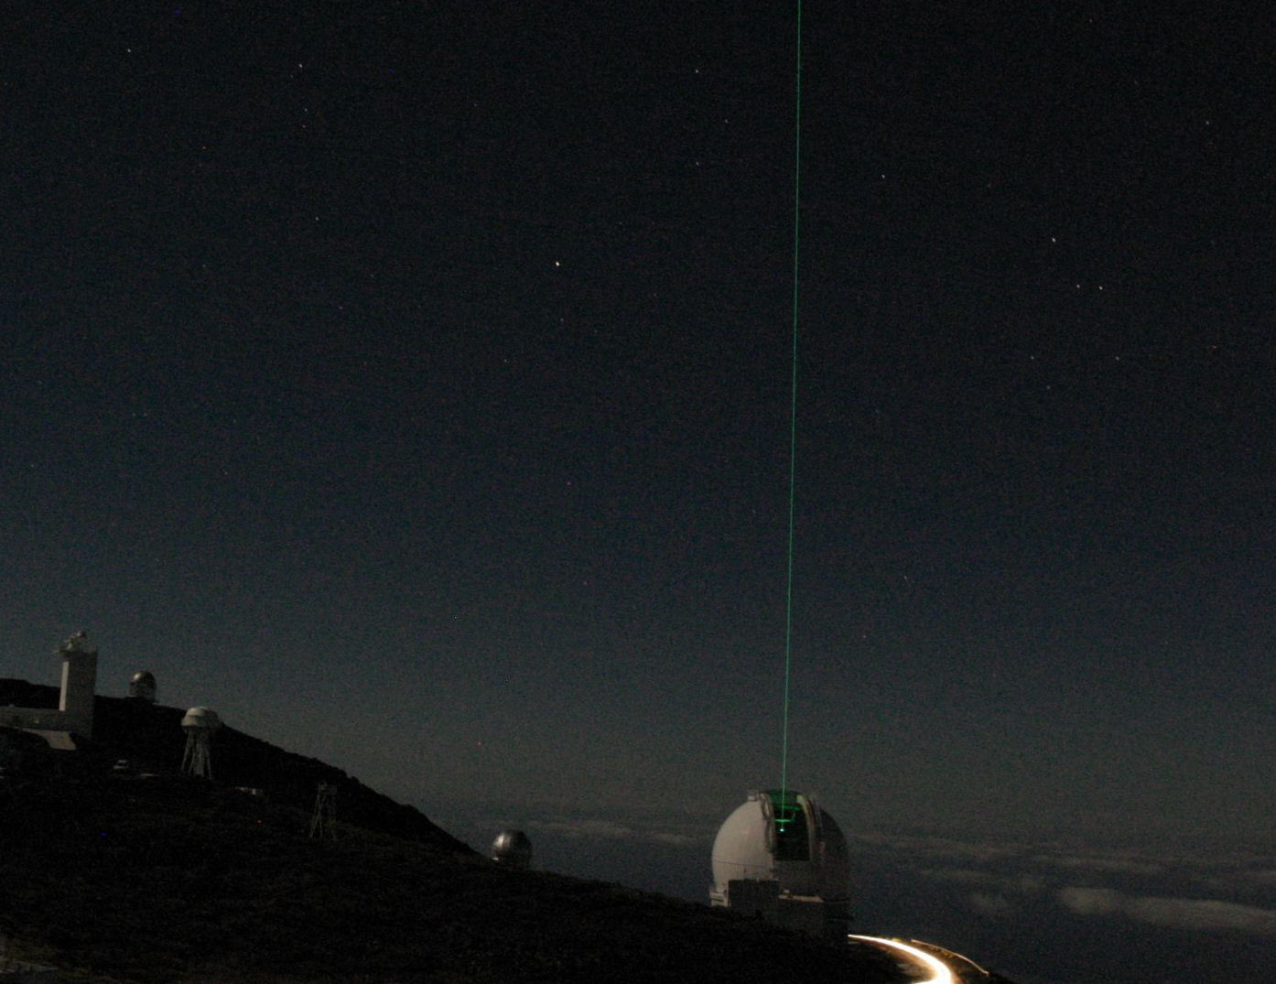
The CANARY team
Durham | Richard Myers, Gordon Talbot, Nigel Dipper, Deli Geng, Eddy Younger, Alastair Basden, Colin Dunlop, Nik Looker, Tim Butterley, Laura Young, Simon Blake, Sofia Dimoudi, Paul Clark, Nazim Bharmal, Richard Wilson Harry Shepherd
Observatoire de Paris | Zoltán Hubert, Gerard Rousset, Eric Gendron, Fabrice Vidal, Damien Gratadour, Aglae Kellerer, Michel Marteaud, Fanny Chemla, Phillipe Laporte, Jean-Michel Huet, Matthieu Brangier, Olivier Martin, Mathieu Cohen
UKATC | Andy Longmore, David Henry, Stephen Todd, Colin Dickson, Brian Stobie, David Atkinson
ONERA | Jean-Marc Conan, Gaetano Sevo, Thierry Fusco, Clelia Robert, Nicolas Vedrenne
ING | Jure Skvarc, Juerg Rey, Neil O’Mahoney, Tibor Agocs, Diego Cano, Don Carlos Abrams
PUC Santiago | Andres Guesalaga, Dani Guzman
L2TI | Caroline Kulscar, Henri-Francois Raynaud
Engineering and Project Solutions Ltd | Kevin Dee
The CANARY project is supported via the following funding bodies
  STFC
  UK E-ELT Design Study
  EU FP7 Preparatory fund WP9000
  ANR Maui, INSU, Observatoire de Paris
  FP7 OPTICON JRA1

