Slide 1
Challenges in the development of large radio arrays MeerKAT as a case study
Justin Jonas
Associate Director: Science & Engineering SKA South Africa
Professor: Dept. Physics & Electronics, Rhodes University
Realising the Astronomy of the Future – Oxford, 7th June 2012

Slide 2
Overview
MeerKAT as an SKA precursor.
Science
Specifications
Engineering process
Implementation
Technical challenges
Critical technologies
Role of industry
Caveats
Restricted to high-sensitivity, single-pixel, mid-frequency instrument
but still a formidable survey speed

Slide 3
MeerKAT is an SKA precursor
Largest radio telescope in southern hemisphere, one of the largest in the world.
SKA engineering prototype and early science.
Engages SKA community now.
Drive the establishment of the Karoo Radio Astronomy Reserve.
New: 25% of SKA₁ mid-frequency single pixel feed array.
SKA-mid “Phase 0”

Slide 4
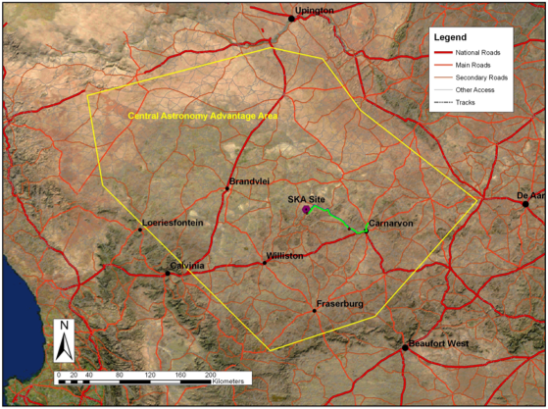
Karoo site
500 km

Slide 5
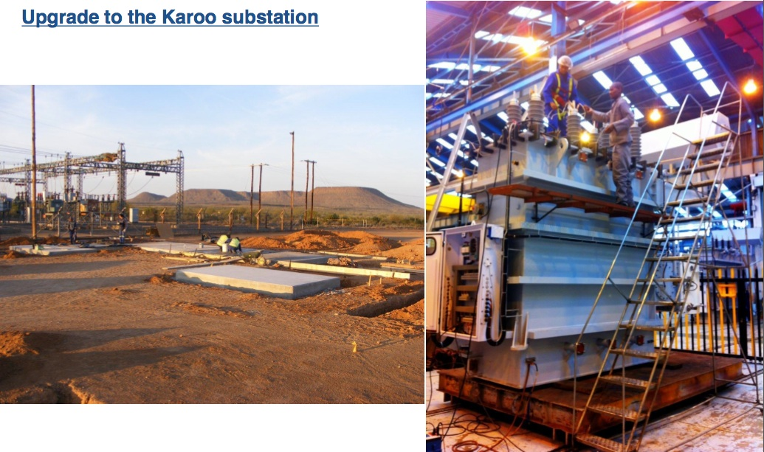
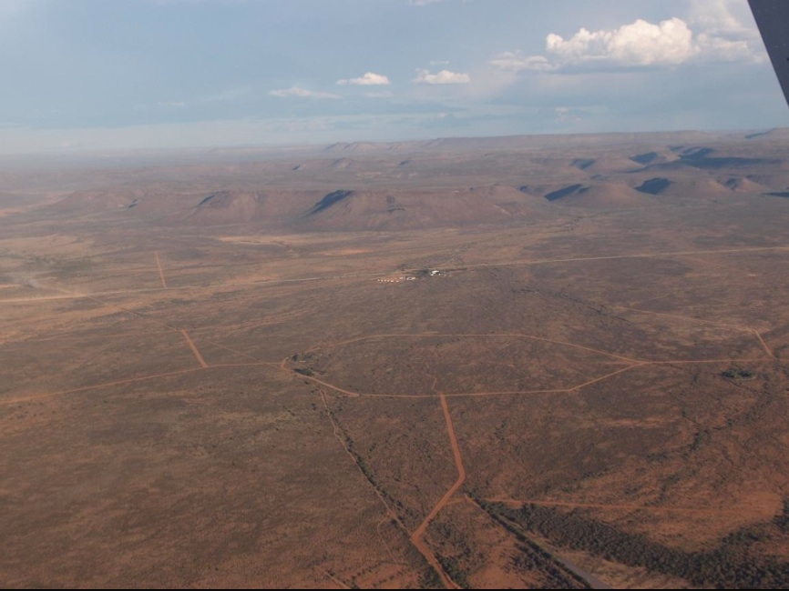
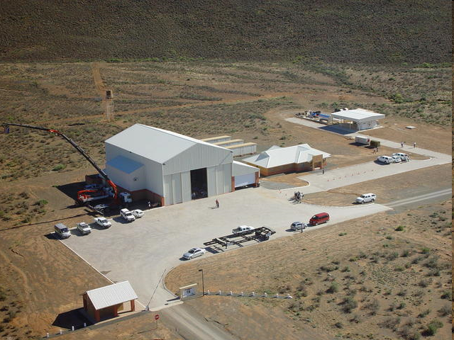
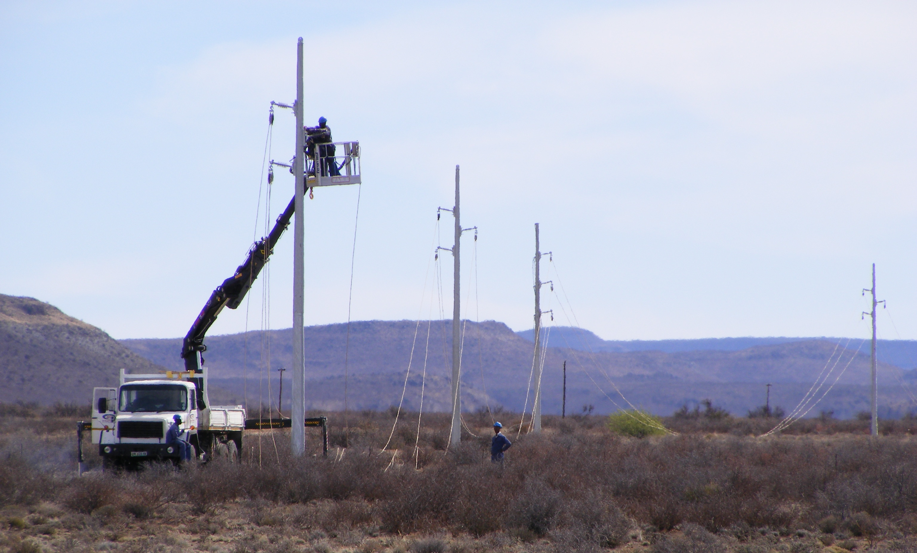
Infrastructure

Slide 6
MeerKAT Large Surveys
Highest priority (cf SKA₁):
Deep HI field
Radio Pulsar Timing
Compelling:
HI and continuum mapping of 30 nearby galaxies
Absorption line survey
Molecules in the EoR
Detecting fast transients and pulsars
HI survey of Fornax
X-band Galactic plane survey
Tiered continuum survey
Slow radio transient survey
Also
VLBI
Cosmic Magnetism
SKA₁ science?

Slide 7
MeerKAT Large Surveys
22 countries

Slide 8
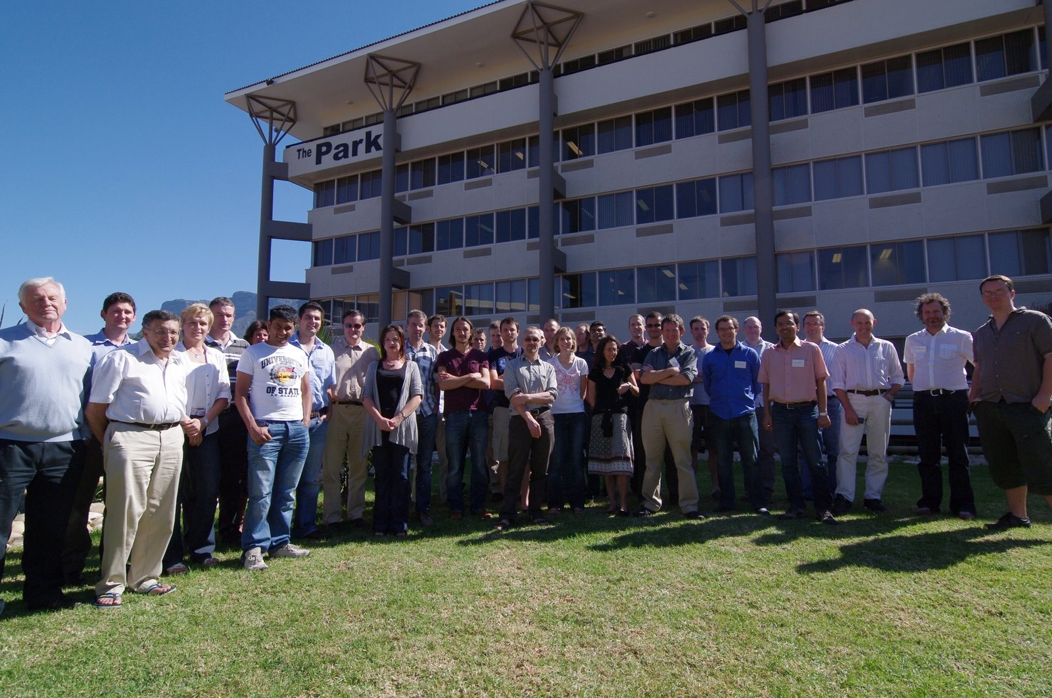
MeerKAT Large Survey PIs (17-18 April 2011)
MeerKAT office

Slide 9
MeerKAT high-level spec
The most sensitive cm-wavelength telescope in the southern hemisphere (aspiration: world)
580 MHz – 15(+) GHz (i.e. SKA-mid +)
Imaging and non-imaging modes
High filling factor for baselines < 1 km
Initial baselines out to 8 km (but SKA₁ will extend to 180 km)

Slide 10
System engineering & design
Science-led process
Science case
➔ User Requirement Specification
➔ Requirements Review
➔ System Specification
➔ Concept exploration and prototypes
➔ Concept and Preliminary design reviews (system)
➔ Subsystem specifications, technology choice, design and reviews

Slide 11
System CoDR (5-8 July 2010)
System-wide trade-offs
Gregorian offset antennas
Sensitivity
Spectral & imaging dynamic range
Multiple receivers
RFI rejection
64 x 13.5 m
Cryo-cooled, octave band, single pixel receivers
Per-dish sensitivity (4 m²/K)
Direct digitization
Spectral dynamic range
Software collaboration
CASA

Slide 12
Sensitivity and Dynamic Range
“Sensitivity (A_{e}/T_{sys}) is king (HI and pulsars), and DR is the dominant queen” (cf trade-space discussion in SPHERE talk yesterday)
Interpretation:
T_{sys} not compromised/traded with e.g.:
ultra-wide bandwidth receivers
rather have multiple ~octave bandwidth receivers
wide FoV receivers
survey speed comes from (A_{e}/T_{sys})²
A_{e} driven by primary beam performance (as a proxy for imaging DR, see later)
including sidelobes, polarization and T_{spill}
Spectral DR also considered
gain ripple

Slide 13
Measurement Equation
Calibration of antenna-based “errors”. Generalized from Hamaker, Bregman & Sault to include “image plane effects” (DDEs):
Kemball, Cornwell & Yashar, CPG Memo #4
Noordam & Smirnov, MeqTrees

Slide 14
Implications for receptor
Low contributions to T_{sys}
Low spillover & correlated ground signals
Minimize scattering structures
Maximize A_{e} for specified sidelobe envelope
Minimize/eliminate aperture blockage
Multiple receivers
A_{e}/T_{sys} and DR have priority over Rx BW, therefore >1 Rx
Predictable, time-stable, frequency-smooth and limited (l,m) support E-Jones
Solid angle used for calibration/imaging
Pointing variation within characteristic calibration timescale
Polarization
Gain ripple
Rotational symmetry of inner beam pattern (P-Jones)
Gain variation within characteristic calibration timescale
Low far-out sidelobes
Minimize scattering structures
Clean RF signal path (G- and B-Jones)
Cable routing
Direct digitization
Self-generated RFI

Slide 15
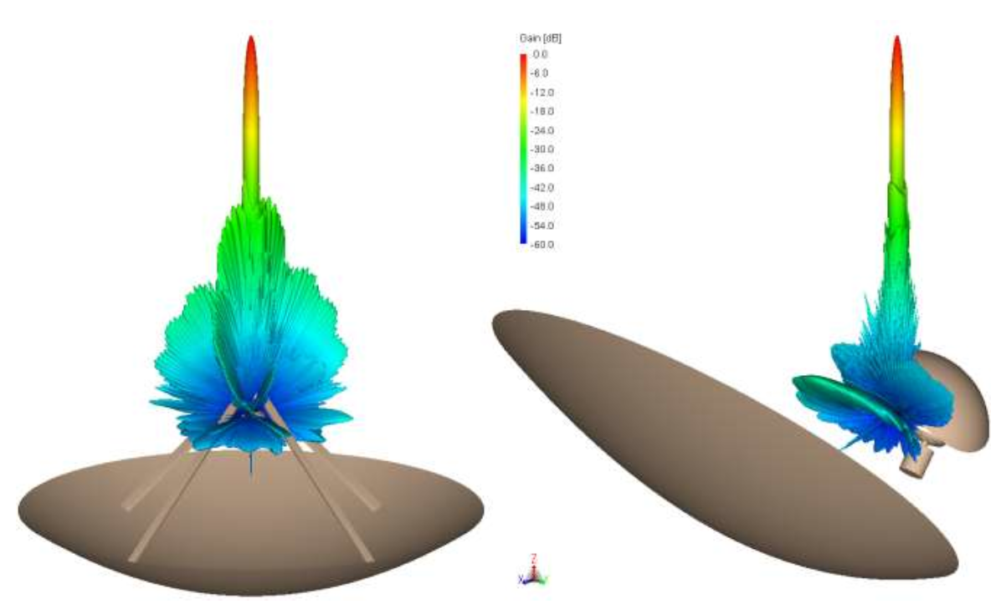
Comparative beam patterns

Slide 16
Prior to Concept Design Review
KAT-7 antenna
Single cryogenic octave-band receiver
Single-reflector symmetric centre-fed antenna with aperture blockage
Analogue signal transport and remote digitization

Slide 17
SKA Baseline Design
Dual offset reflectors
Multiple cryogenically-cooled octave-band receivers
Gregorian offset dual-reflector antennas
Allows multiple receivers without aperture blockage
Superior RFI rejection
Superior sensitivity and signal fidelity
Cryogenically cooled octave-band receivers
Superior sensitivity and signal fidelity
Direct digitization
Superior signal fidelity
Direct digitization at the receiver

Slide 18
MeerKAT PDR – July 2011
Extensive trade-off between optical and mechanical aspects of antenna
Mechanical tolerance impacting optical performance
Materials testing and component durability
Accelerated environmental and operational tests
Receiver cryogenic refrigeration options
Stirling cycle vs G-M cycle

Slide 19
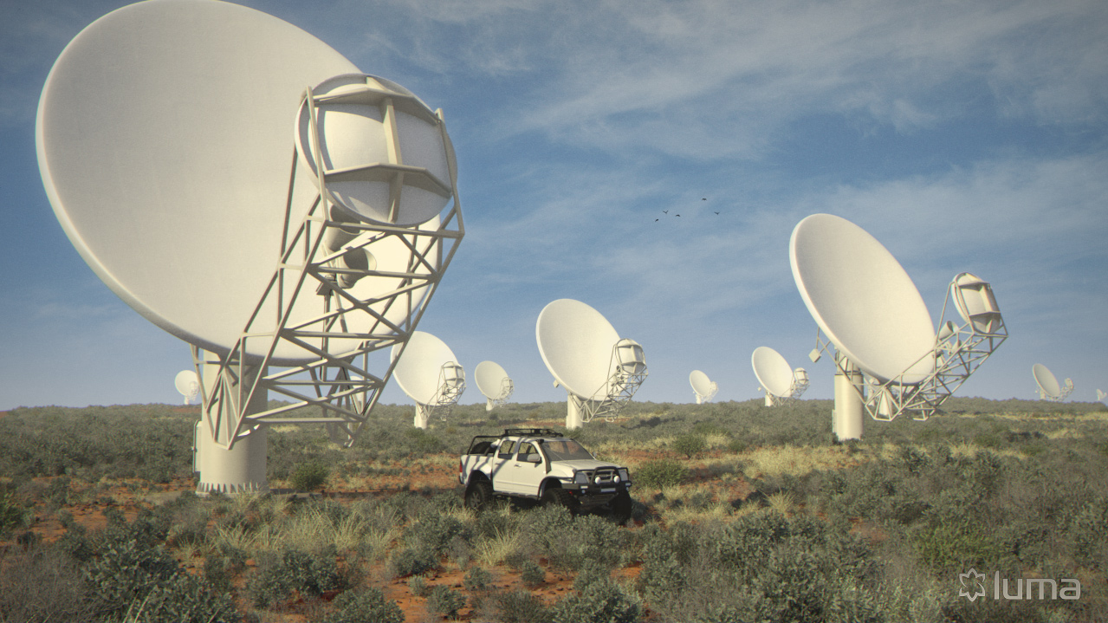
Virtual MeerKAT

Slide 20
MeerKAT Phase 1 (2016)
64 x 13.5 m gregorian offset antennas
>> 220 m²/K (300 m²/K goal)
8 km maximum baseline
70 % in < 1km diameter core
0.9-1.726 GHz cryogenic single-pixel receiver (L-band)
Multiple feed indexer
Direct digitization
DFX architecture

Slide 21
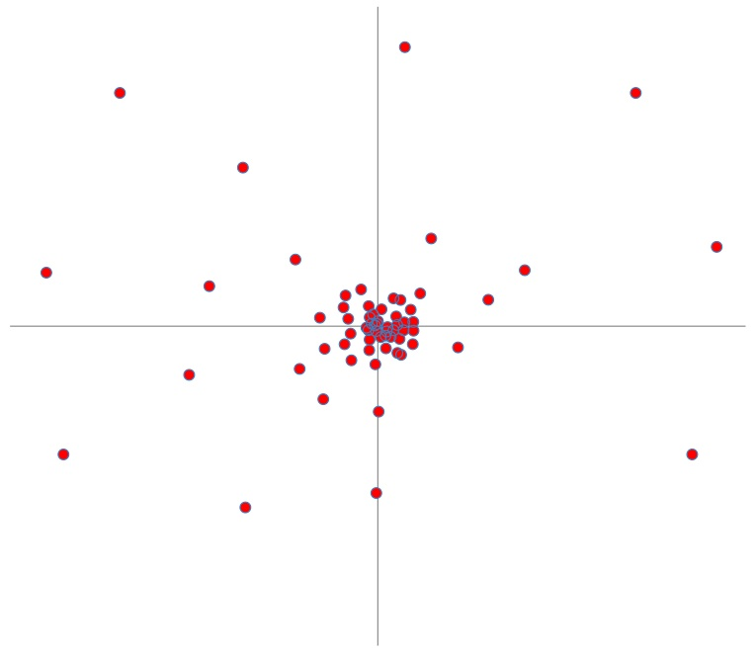
Configuration (64 antennas)
8 km

Slide 22
Future Phases
Phase 2: 580-1000 MHz (UHF-band)
Phase 3: 8-14.5 GHz (X/Ku-band)
Aspirations (contingent on SKA₁ requirements, money and/or technology availability):
20+ km baselines
1.5-3 GHz for precision pulsar timing
5-22 GHz wideband receiver (hi-Z CO)

Slide 23
Technical Challenges
Excluding “big data”, but including “fast data”
Cheap dishes with perfect performance.
Cheap, low power, wideband receivers with perfect performance.
Cheap, low power, high bandwidth digitizers with perfect performance.
Cheap, low power, high bandwidth data transport.
Cheap, low power array processing hardware (both imaging and non-imaging).
3G calibration and imaging algorithms.

Slide 24
Examples of cost scaling
N⁰
Engineering NRE
Some infrastructure (e.g. roads)
N¹
Reticulation infrastructure (e.g. power, antenna data)
Antennas and receivers
N²
Array processing (and associated power)
N^{>2}
Off-line processing (and associated power)

Slide 25
Dishes
Single most expensive item.
UHF/L-band performance key spec driver
Higher frequencies “for free”
Inflation linked costs (materials, labour).
No easy/feasible upgrade or retrofits.
64/250/3000 are big numbers, but fall short of full-scale mass production.
Cannot be optimized in isolation of overall system.
But sensitivity, survey speed and dynamic range are key characteristics.

Slide 26
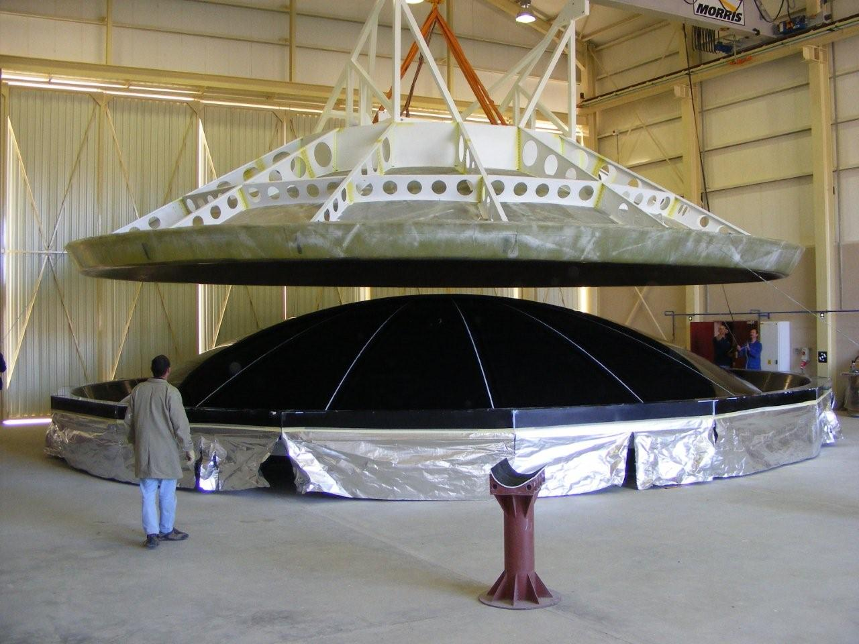
Notes:
26

Slide 27
Receivers
As with dishes, have to be optimized at a system level.
But T_{N}, bandwidth, gain ripple are key characteristics.
Wideband horns, OMTs and LNAs are active areas of investigation.
Electrical losses contribute to T_{N}.
T_{sys} trades with A_{e}, so cryogenic cooling advantageous
unless dish cost reduces.
but cryo-cooling expensive.

Slide 28
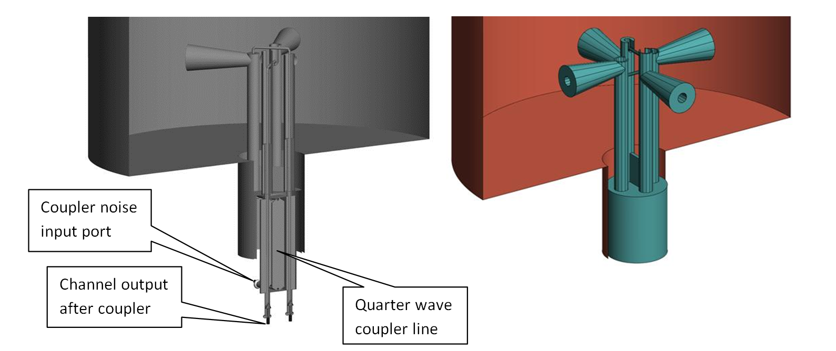
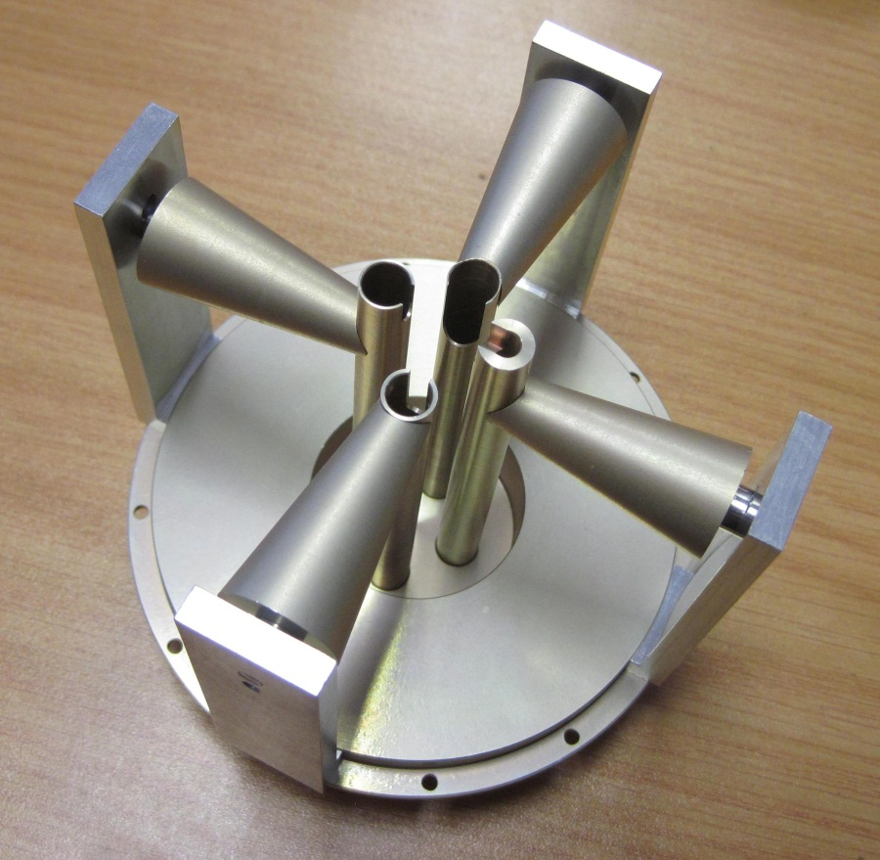
Maxwell rules!

Slide 29
Digital systems
Hope to ride commodity digitizer roll-out.
SFDR and ENoB performance often not science quality.
Ditto for data transport.
But array provided uni-directional data flow.
Commodity FPGAs, GPUs, CPUs, etc provide building blocks.
But architectures need to be optimized for our requirements.
Power consumption, heat extraction and RFI shielding are challenges.
Fast transient surveys requiring intra-beam pixelization and period, period acceleration and DM trials are the performance driving mission.

Slide 30
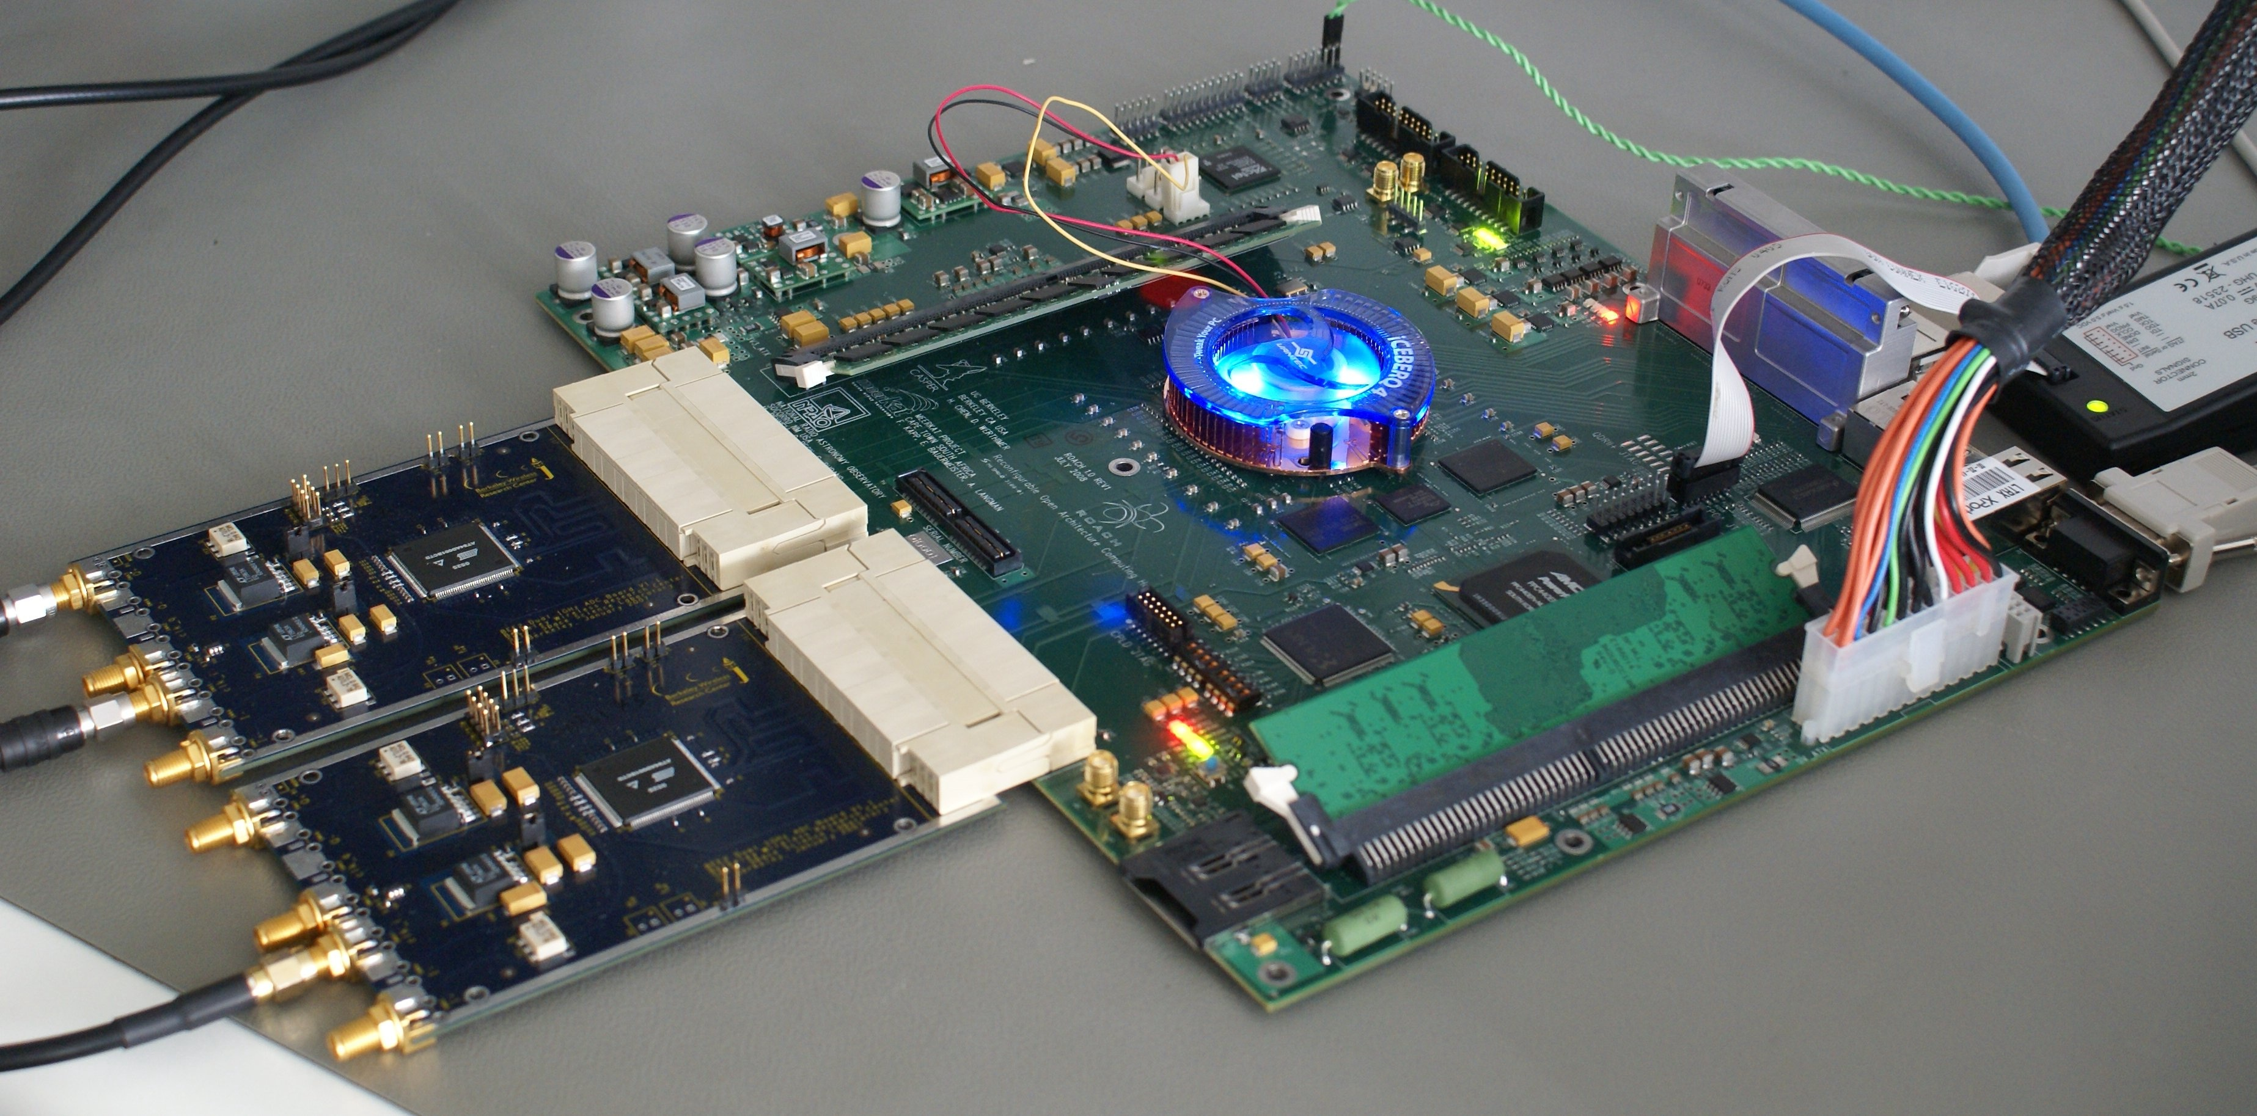
CASPER / ROACH
Notes:
Development of the first two prototype CASPER/ROACH boards. Designed by MeerKAT DSP team in cooperation with UCB, laid out at NRAO, being debugged at MeerKAT office. Looks good so far.

Slide 31
Will industry provide innovation?
Yes, if:
commodity items provide our requirements.
Moore’s law components.
there is a clear path to profit.
there is shared interest that will lead to commercially competitive intellectual property (in a benign and open environment).
a non-commercial partner is willing to share risk.
No, if no sustainable business model.

Slide 32
Issues with industry
We need them more than they need us:
Industrial processes are required to take our laboratory prototypes to reliable, cheap manufacture.
Our quantities (dish arrays) are not always large enough to reach mass production thresholds (even 3000 dishes).
Nothing attracts industry more than a real contract:
Expectation management important.
There is no motivation for them to drive down costs unless they have a future market.
What they do like about us:
We push technical boundaries.
We work in a benign and open environment.

Slide 33
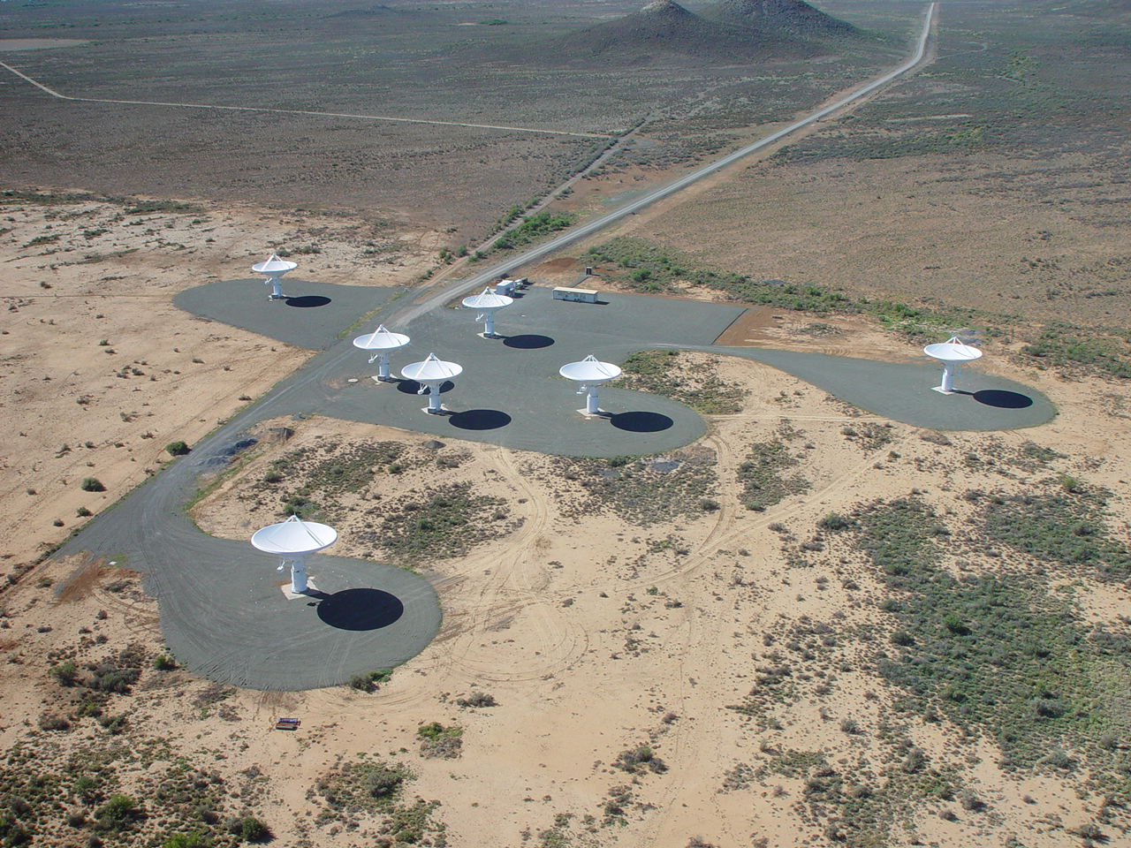
KAT-7

Slide 34
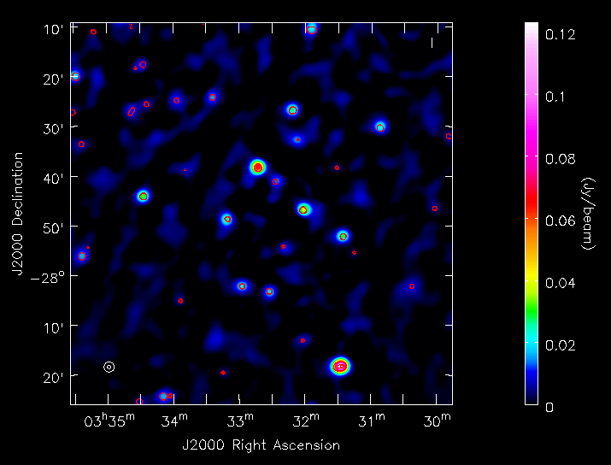
HDF-S & NVSS contours

Slide 35
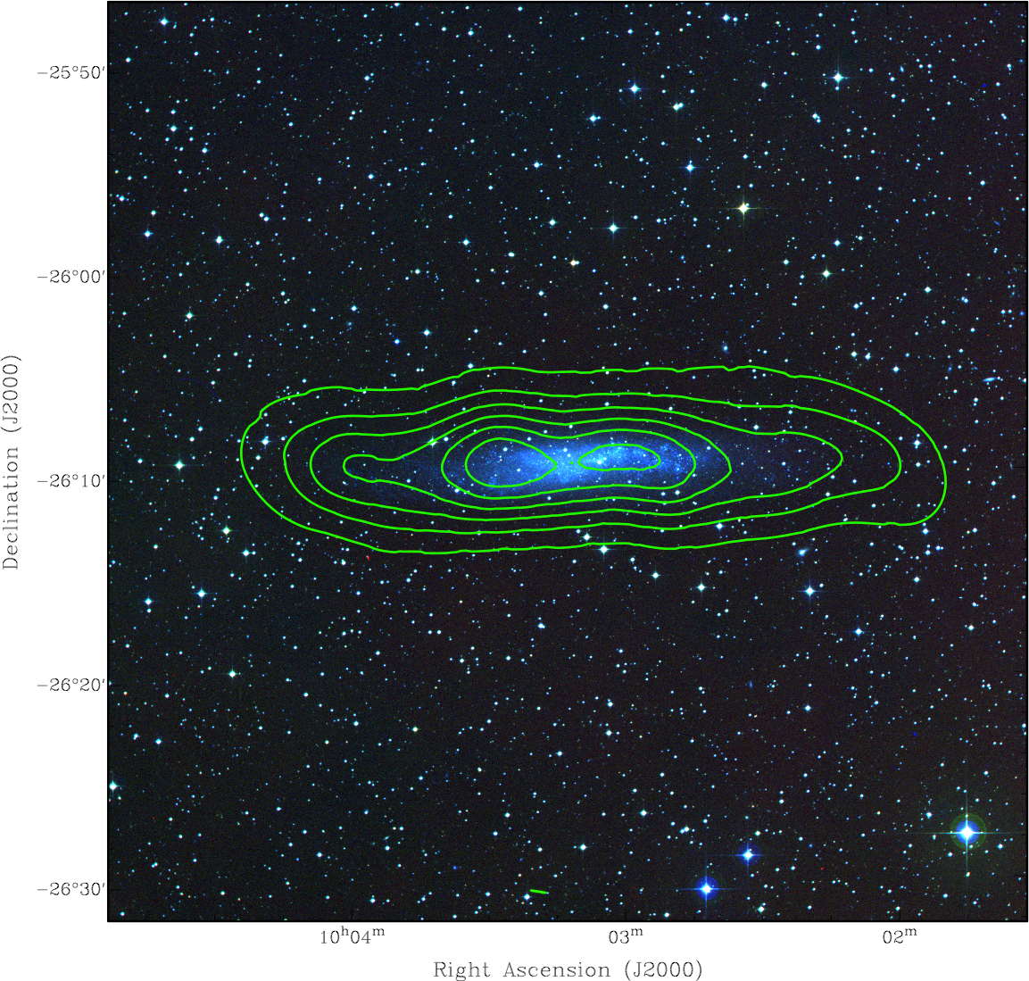
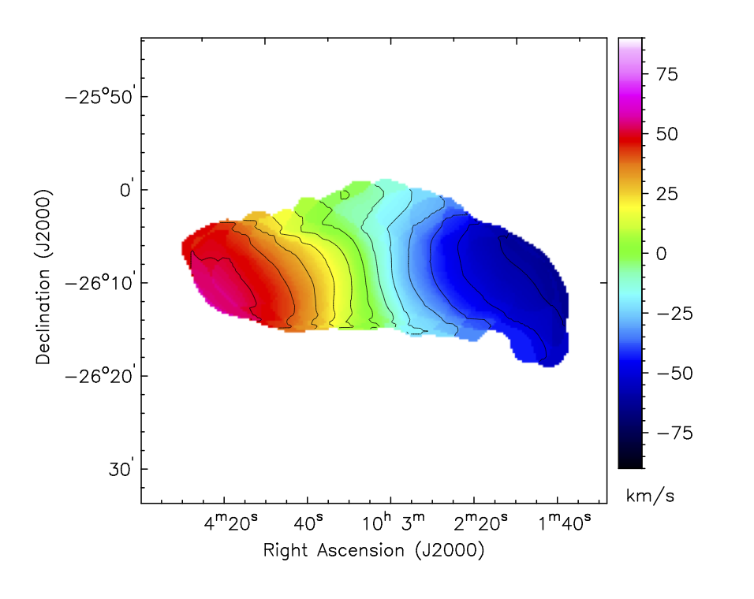
NGC 3109 (HI)

Slide 36
Summary of critical technologies
Low-cost dish manufacture.
“Wideband” receivers.
Wideband feed antennas, OMTs, LNAs.
Low-power, low-maintenance cryogenics.
High-speed, high fidelity digitizers.
Wide-field fast transient detection hardware and algorithms.
3G imaging software.

Slide 37
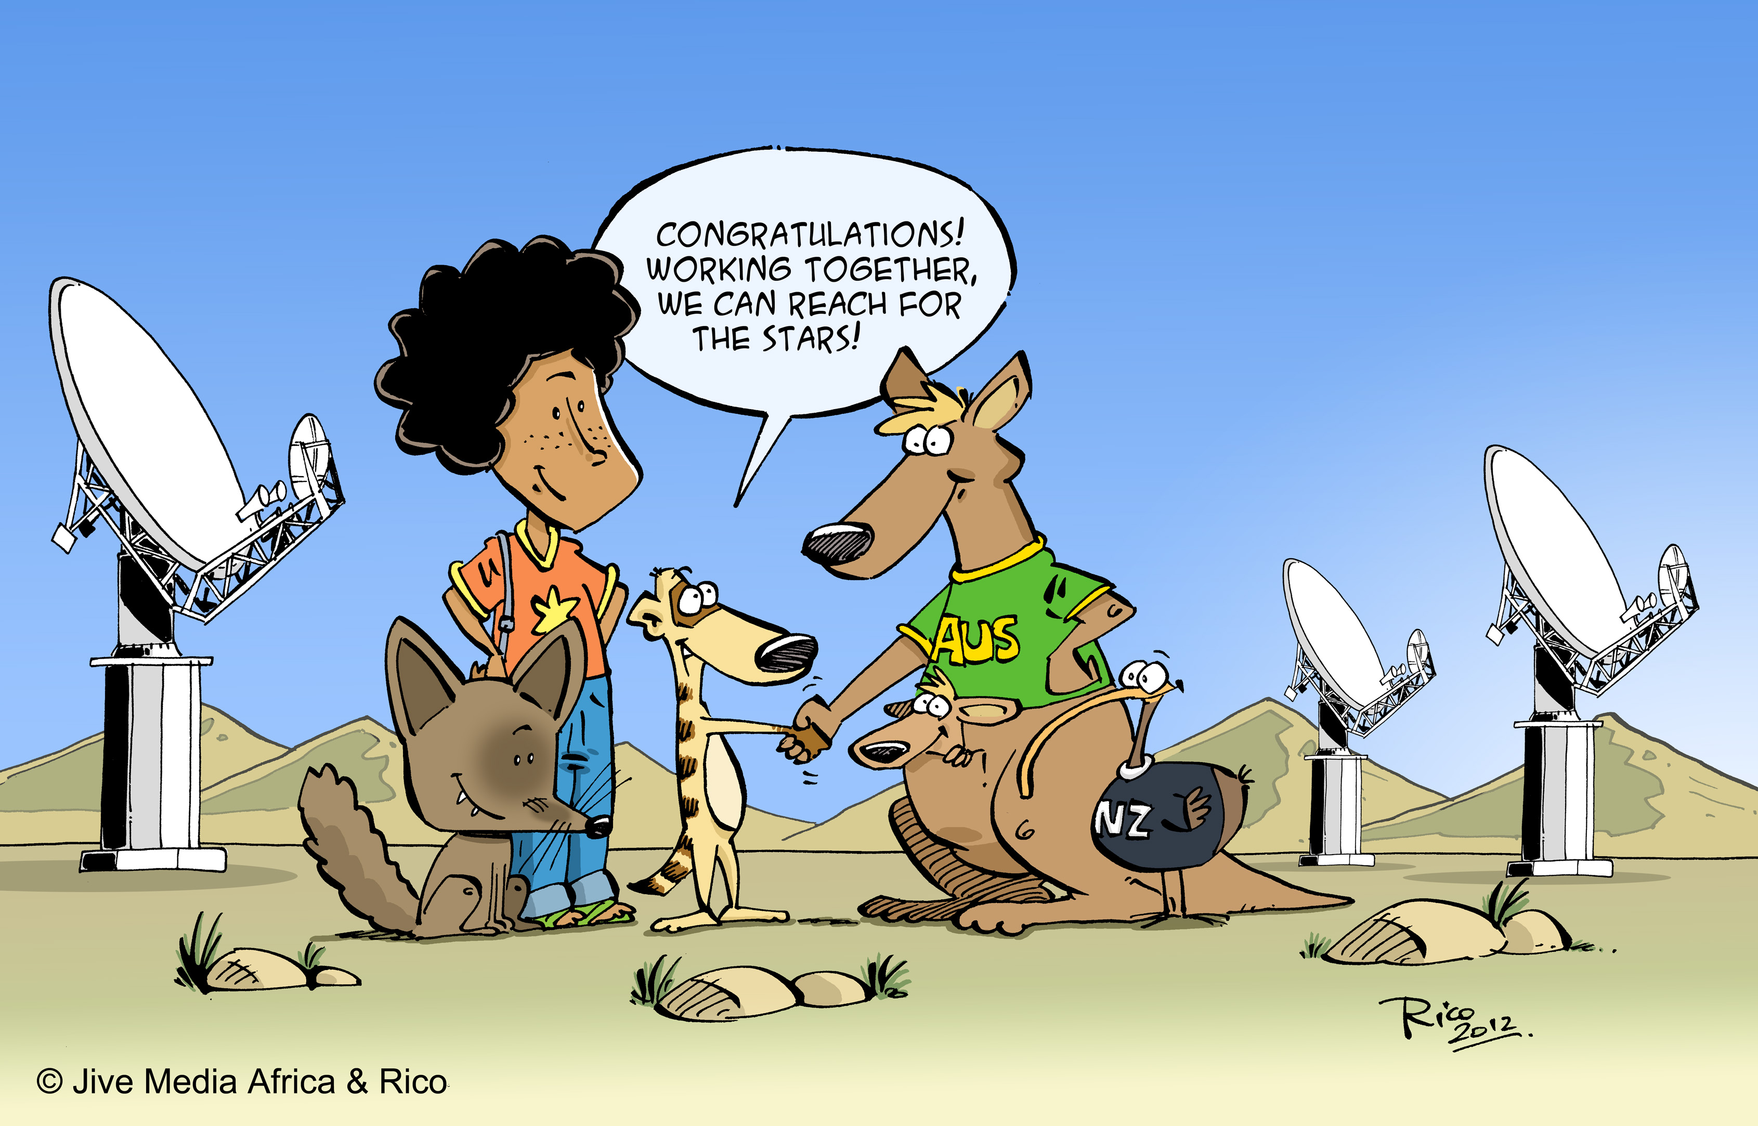
“Peace dividend”
Want a version of this with all SKA partners represented!

Slide 38
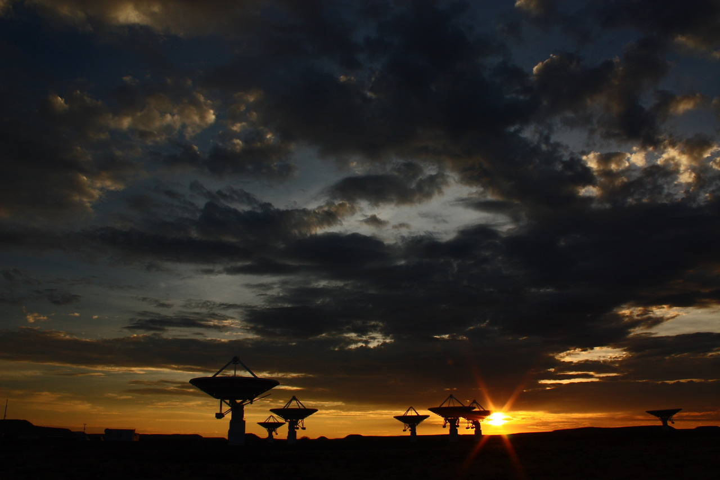
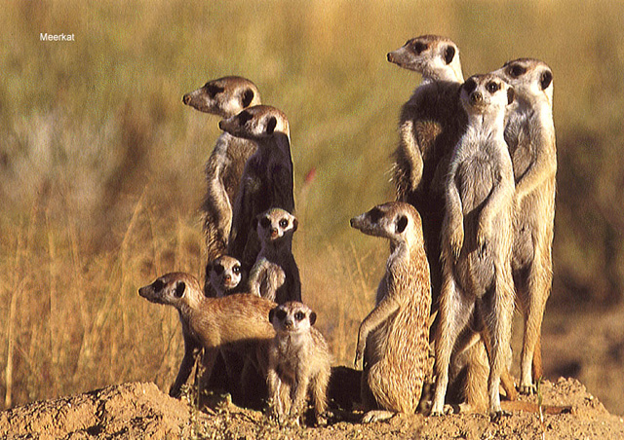
www.ska.ac.za

