Slide 1
Large-scale Data Processing Challenges
David Wallom

Slide 2
Overview
The problem…
Other communities
The pace of technological change
Using the data

Slide 3
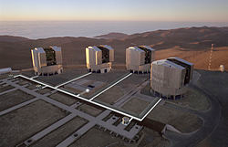
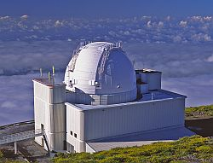
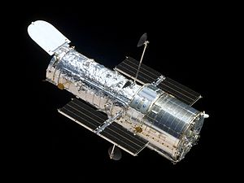
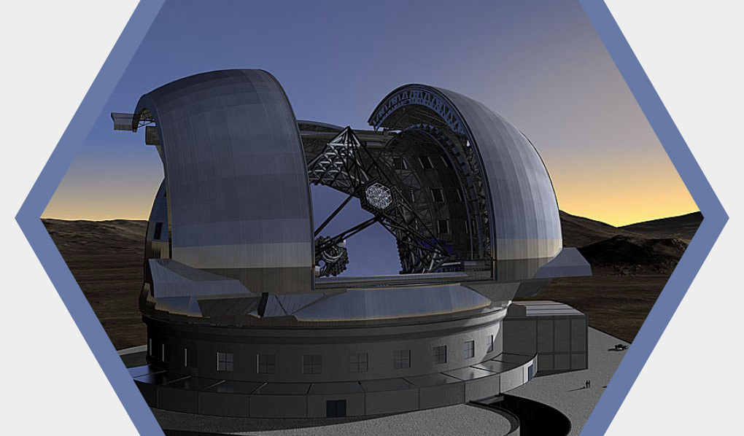
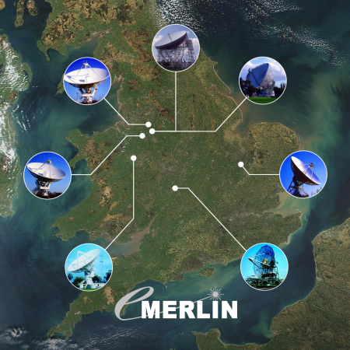

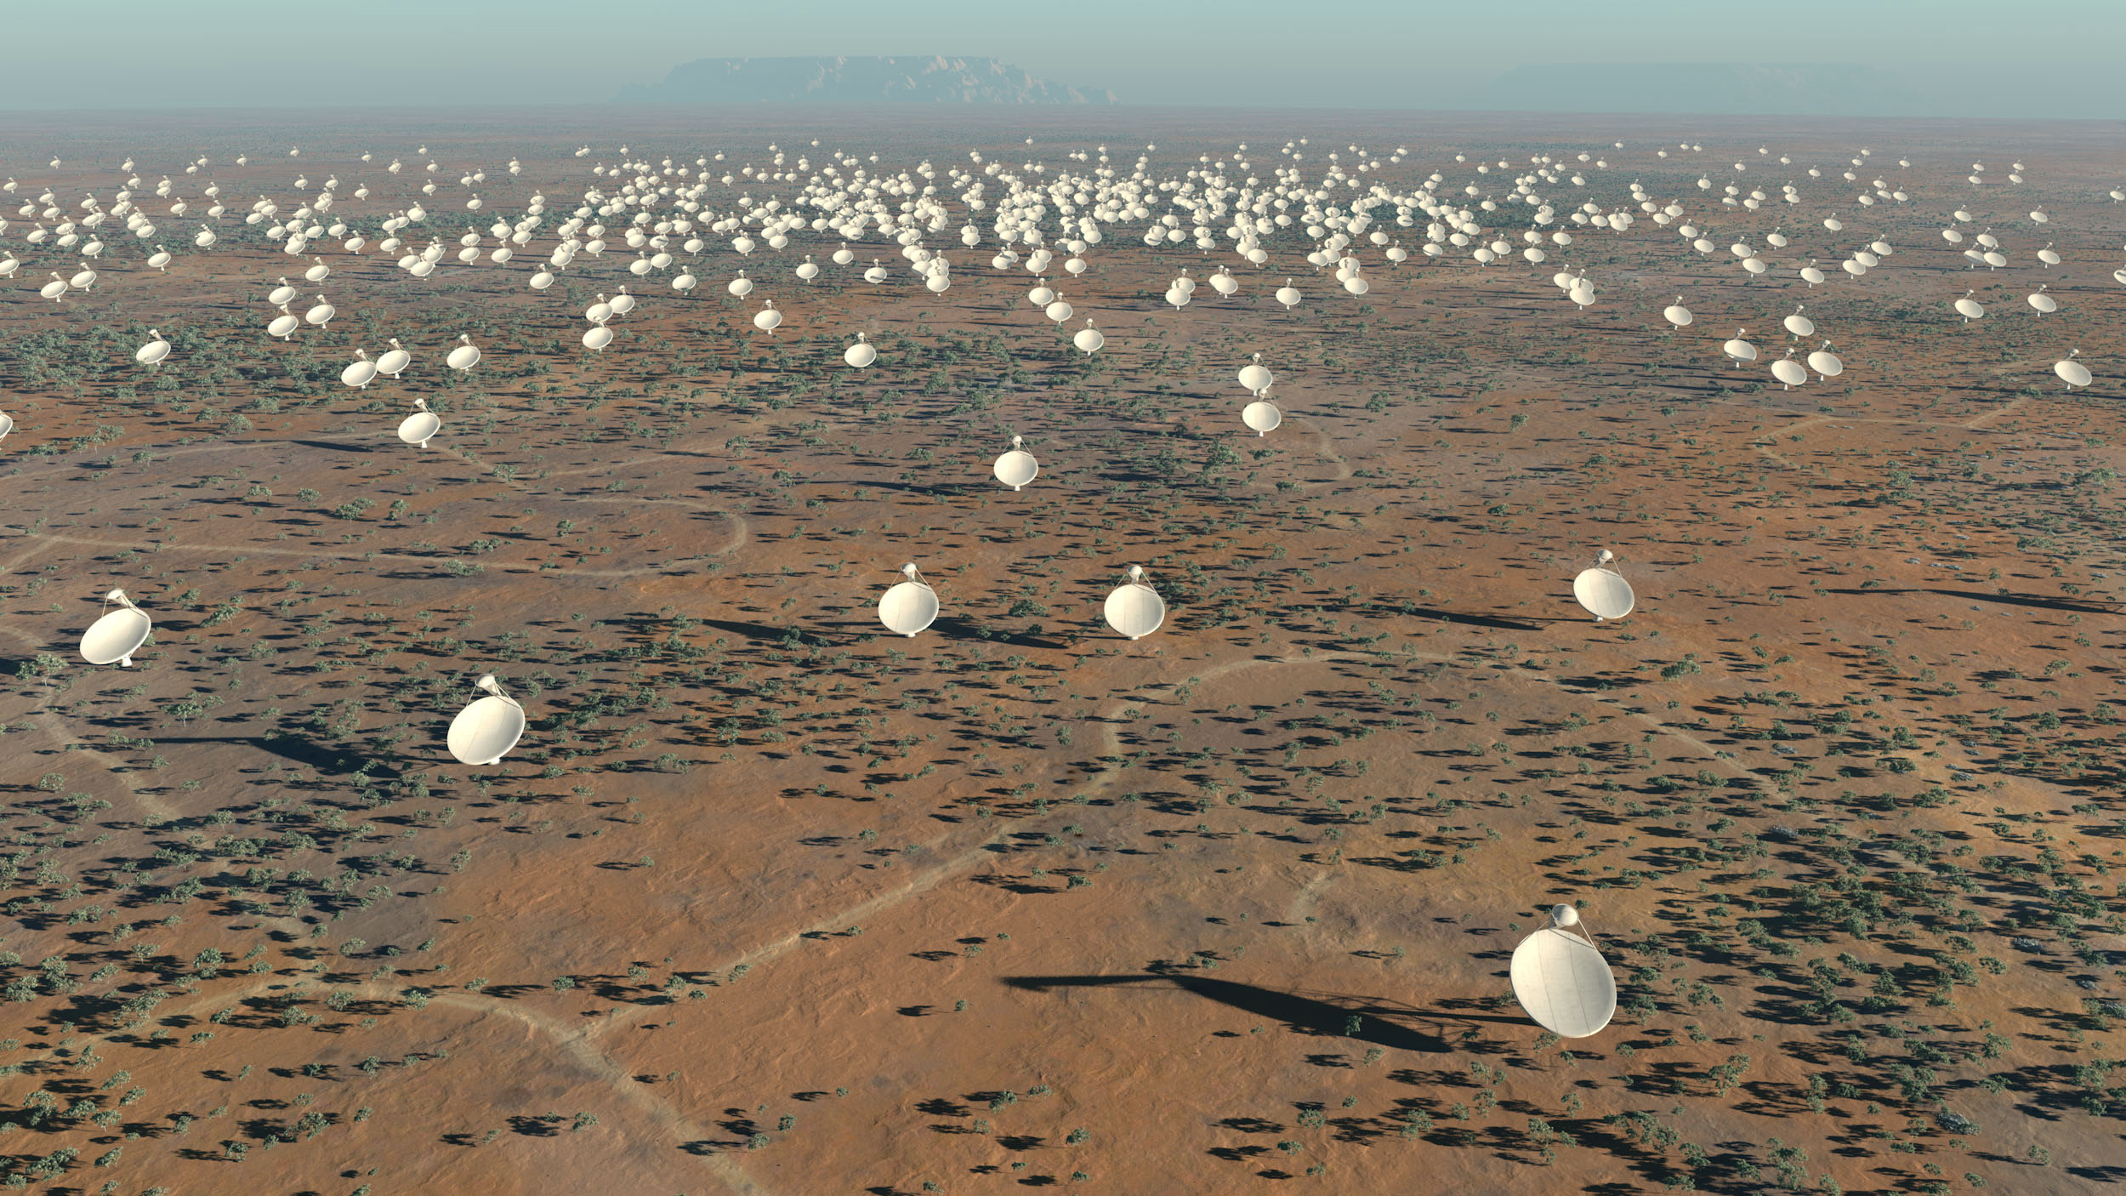
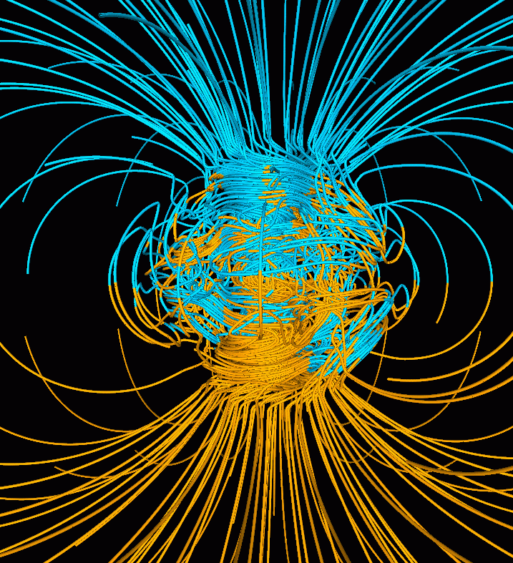
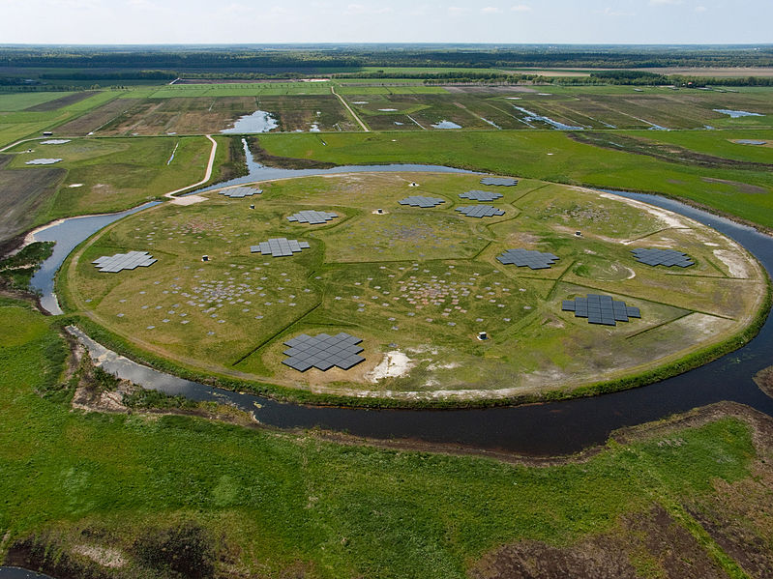
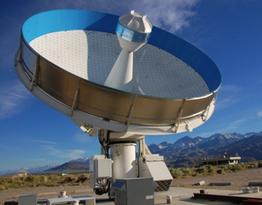
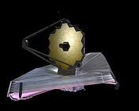
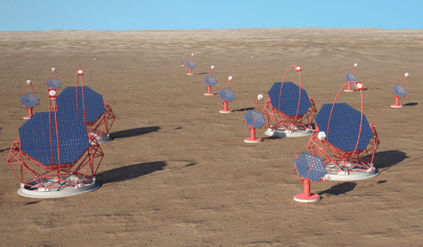
The problem…

Slide 4
New telescopes generate vast amounts of data
  Particularly (but not limited to) surveys (SDSS, PAN-STARRS, LOFAR, SKA…)
  Multi-EBytes per year overall -> requiring large #CPU for product generation let alone user analysis
Physical locations of instruments is not ideal for ease of data access
  Geographically widely distributed
  Normally energy limited so difficult to operate data processing facilities on site
Cost of new telescopes increasing
  Lower frequency of new instruments -> must make better use of existing data
‘Small’ community of professional astronomers
  Citizen scientists are an increasingly large community
  Funders increasingly want to see democratisation of access to research data

Slide 5
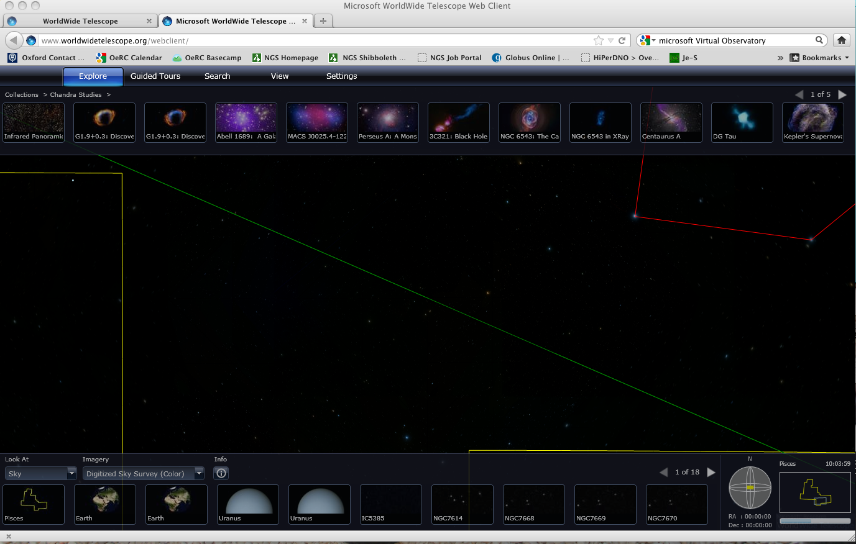
Example – Microsoft Worldwide Telescope

Slide 6
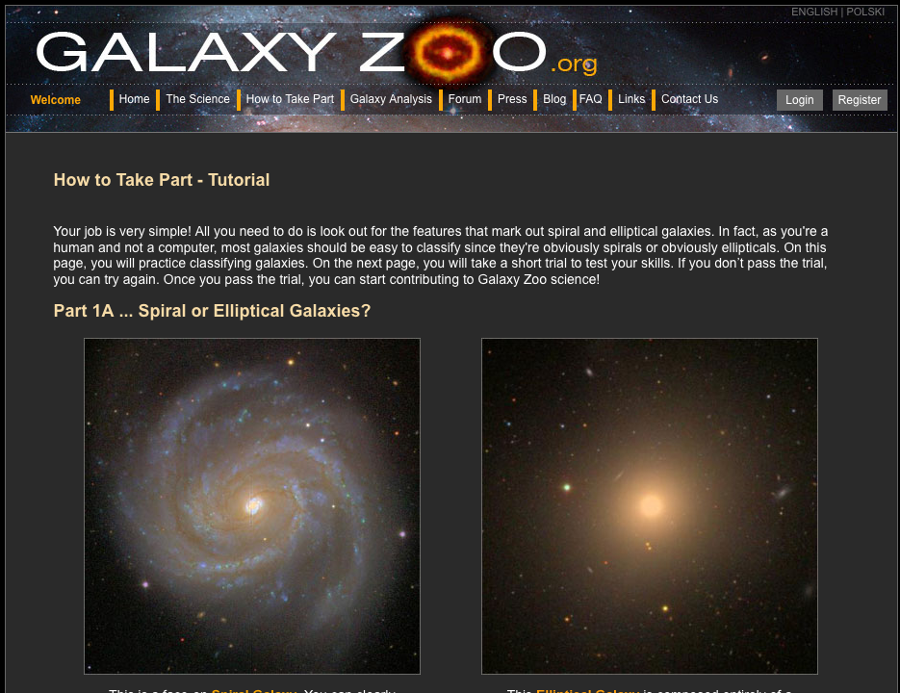
Example – Galaxy Zoo

Slide 7
Other communities experiences of large data

Slide 8
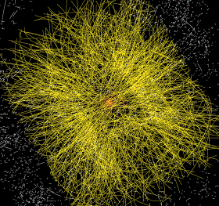
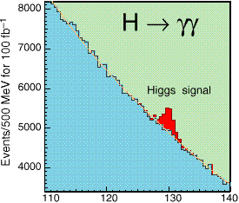
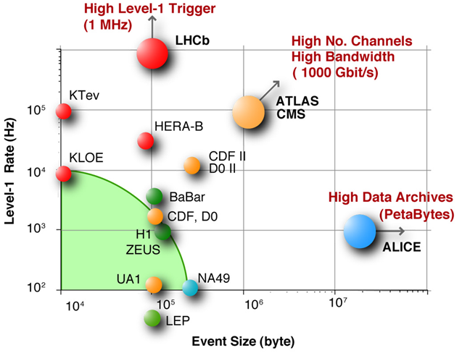
The LHC Computing Challenge
Signal/Noise: 10⁻¹³ (10⁻⁹ offline)
Data volume
  High rate * large number of channels * 4 experiments
  ➔ 15 PetaBytes of new data each year
Compute power
  Event complexity * Nb. events * thousands users
  200 k of (today's) fastest CPUs
  45 PB of disk storage
Worldwide analysis & funding
  Computing funding locally in major regions & countries
  Efficient analysis everywhere
  ➔ GRID technology
>200 k cores today
100 PB disk today!!!
>300 contributing institutions
Notes:
The challenge faced by LHC computing is one primarily of data volume and data management. The scale and complexity of the detectors – the large number of “pixels” if one can envisage them as huge digital cameras, and the high rate of collisions – some 600 million per second – means that we will need to store around 15 Petabytes of new data each year. This is equivalent to about 3 million standard DVDs.
In order to process this volume of data requires large numbers of processors: about 250,000 processor cores are available in WLCG today, and this need will grow over the coming years, as will the 45 PB of disk currently required for data storage and analysis.
This can only be achieved through a worldwide effort, with locally funded resources in each country being brought together into a virtual computing cloud through the use of grid technology.

Slide 9
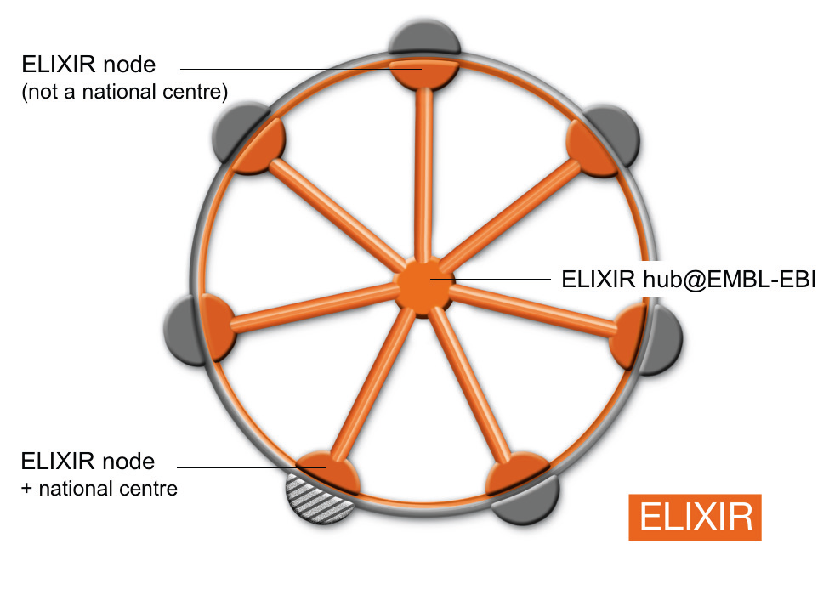
ELIXIR: Europe’s emerging infrastructure for biological information
Literature and
ontologies
Literature and
ontologies
CitExplore
, GO
Life sciences
Medicine
Agriculture
Pharmaceuticals
Biotechnology
Environment
Bio-fuels
Cosmaceuticals
Neutraceuticals
Consumer products
Personal genomes
Etc…
CitExplore
, GO
Genomes
Genomes
Nucleotide sequence
Ensembl
,
Ensembl
Nucleotide sequence
Ensembl
,
Ensembl
EMBL
-
Bank
Genomes,
EGA
EMBL
-
Bank
Genomes,
EGA
Proteomes
Proteomes
Gene expression
UniProt
, PRIDE
Gene expression
UniProt
, PRIDE
ArrayExpress
ArrayExpress
Protein structure
Protein structure
PDBe
Protein families,
PDBe
Protein families,
motifs and domains
motifs and domains
Chemical entities
InterPro
Chemical entities
InterPro
ChEBI
,
ChEMBL
Protein interactions
ChEBI
,
ChEMBL
Protein interactions
IntAct
IntAct
Pathways
Pathways
Reactome
Reactome
National nodes integrated
into the overall system
Systems
Systems
BioModels
BioModels
Central Redundant Ebyte capacity Hub

Slide 10
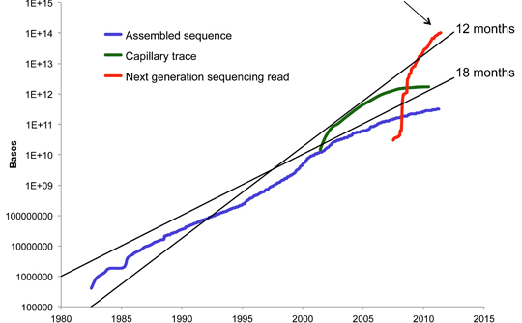
9 months
Newly generated biological data is doubling every 9 months or so - and this rate is increasing dramatically.

Slide 11
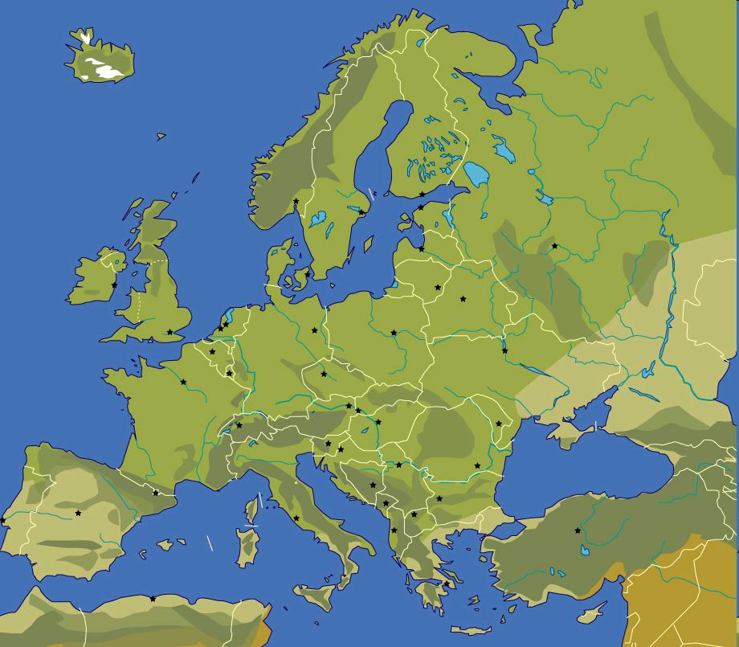











Infrastructures
European Synchrotron Radiation Facility (ESRF)
Facility for Antiproton and Ion Research (FAIR)
Institut Laue–Langevin (ILL)
Super Large Hadron Collider (SLHC)
SPIRAL2
European Spallation Source (ESS)
European X-ray Free Electron Laser (XFEL)
Square Kilometre Array (SKA)
European Free Electron Lasers (EuroFEL)
Extreme Light Infrastructure (ELI)
International Liner Collider (ILC)
Notes:
The first slide indicates the projects
Upgrade of existing facilities (on a single site)
New projects (single site)

Slide 12
Distributed Data Infrastructure
Support the expanding data management needs
  Of the participating RIs
Analyse the existing distributed data infrastructures
  From the network and technology perspective
  Reuse if possible depending on previous requirements
Plan and experiment their evolution
  Potential use of external providers
    Understand the related policy issues
Investigating methodologies for data distribution and access at participating institute and national centres
  Possibly build on the optimised LHC technologies (tier/P2P model)

Slide 13
Other communities
Media
  BBC
    1hr of TV requires ~25GB in final products from 100-200GB during production
    3 BBC Nations + 12 BBC Regions
    10 channels
    ~3TB/hour moved to within 1s accuracy
    BBC Worldwide
    iPlayer delivery
      600MB/hr – standard resolution, ~x3 for HD
      ~159 million individual program requests/month
      ~7.2 million users/week
    BBC ‘GridCast’ R&D project investigated a fully distributed BBC Management and Data system in collaboration with academic partners

Slide 14
Technological Developments

Slide 15
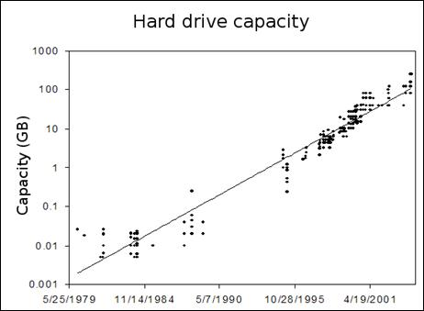
Technological Change and progress – Kryders Law
Notes:
Areal storage density doubling roughly on a 12 month basis for magnetic technologies - extrapolation is that in 2020 a two-platter, 2.5-inch disk drive will be capable of storing more than 14 terabytes (TB)

Slide 16
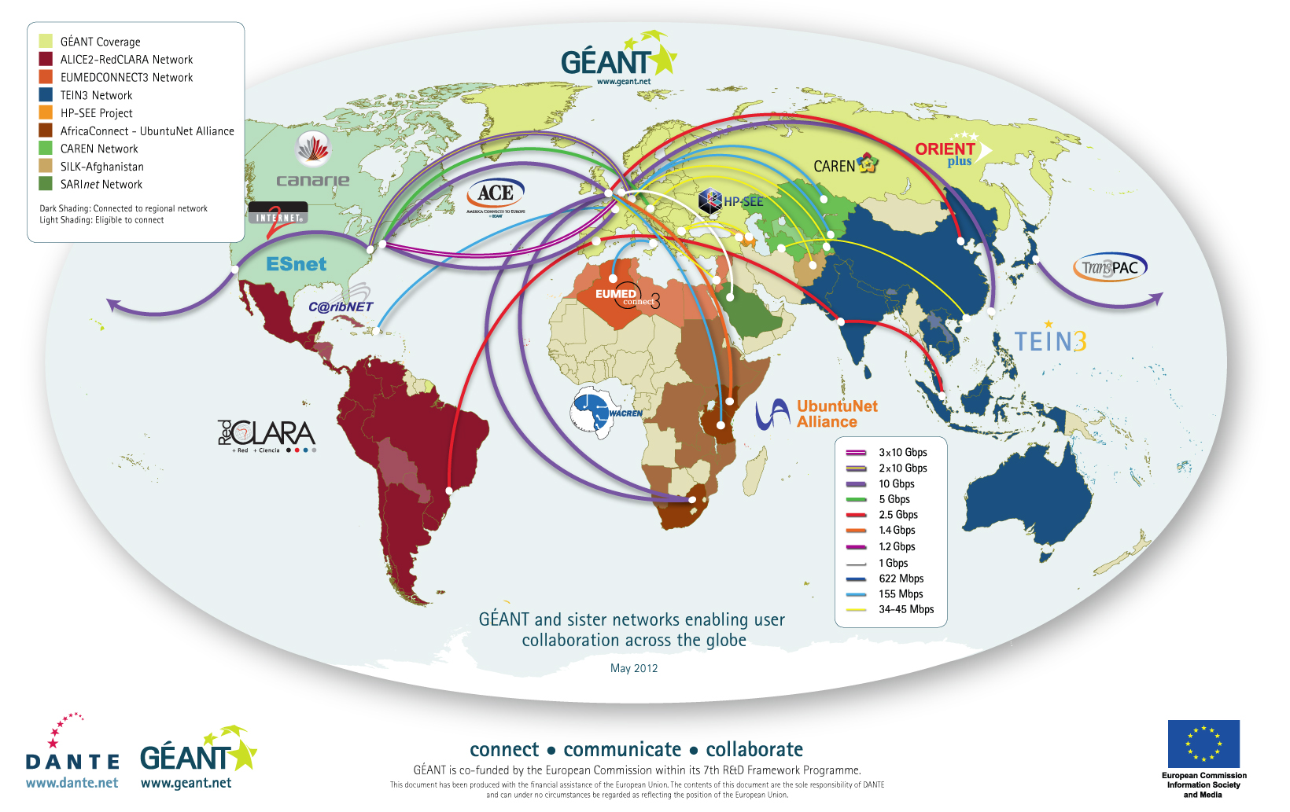
Global Research Network Connectivity
Notes:
Butter's law says that the amount of data coming out of an optical fiber is doubling every nine months
JANET successfully tested 100GB/s for UK backbone upgrades

Slide 17
Data Usage

Slide 18
Current Usage Models
Future Usage Models
Instrument
Product Generation
Instrument
Product Generation
Instrument
Product Generation
Archive
User
Archives
Instrument
Product Generation
Instrument
Product Generation

Slide 19
Archives not an Archive
Historic set of activities around Virtual Observatories
Proven technologies for federation of archives in LHC Experiments with millions of objects stored and replicated
Multiple archives will mean that we have to move the data, next generation network capacity will make this possible, driven by consumer market requirements not research communities
Leverage other communities investments rather than paying for all services yourself

Slide 20
Requires
Standards
  if not data products certainly their metadata to enable reuse
  Must support work of the IVOA
Software and systems reuse
  Reduction of costs
  Increase in reliability due to ‘COTS’ type utilisation
Sustainability
  Community confidence
Community building
  primarily a political agreement

Slide 21
Summary/Conclusion
Data being generated at unprecedented rates but other communities are also facing these problems, we must collaborate as some may have solutions we can reuse
Technology developments in ICT are primarily driven by consumer markets such as IPTV etc.
Operational models will change with increasing usage of archive data with data interoperability a key future issue – the return of the Virtual Observatory?
Acting as a unified community is essential as these new projects are being developed and coming online, supporting researchers who are aggregating data from multiple instruments across physical and temporal boundaries

